Slide 1
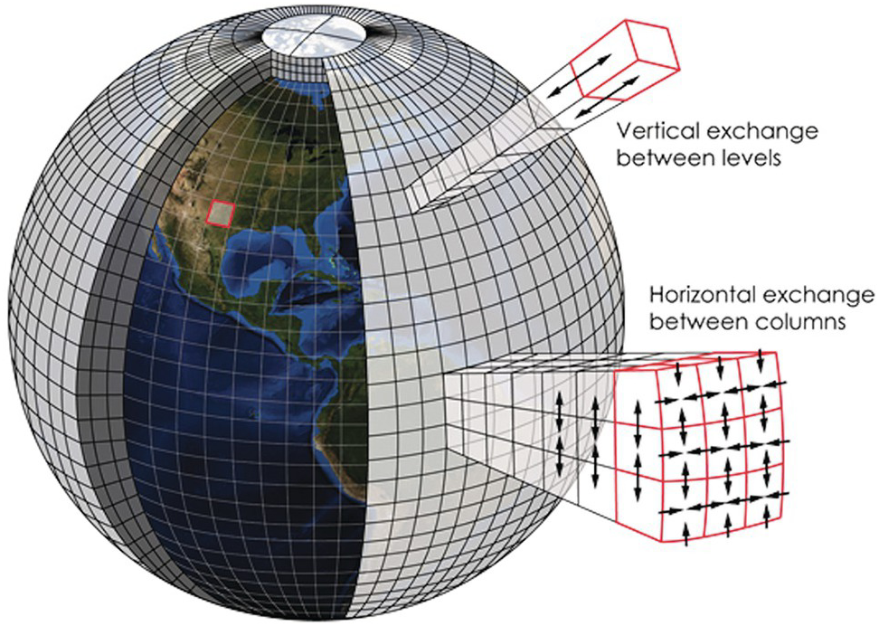


Overview of Climate Modeling
Dr. Kerrie Geil
Research Associate Professor
Geosystems Research Institute
kerrie@gri.msstate.edu
MSU USDA Summer Research Experience, 17 June 2025

Slide 2
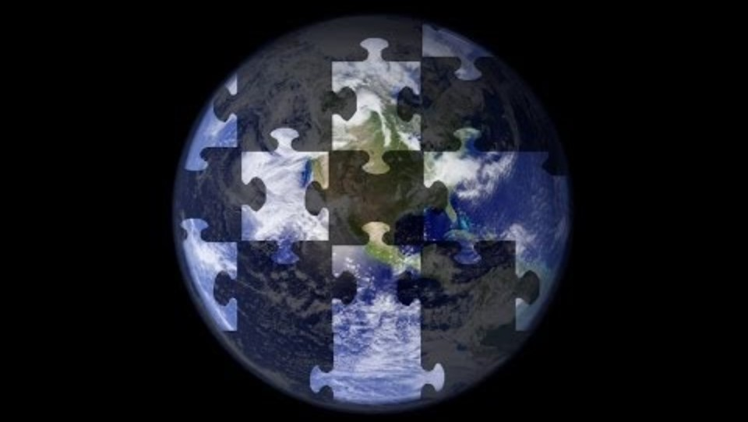

Slide 3
Lecture Overview
The climate system
Intro to climate modeling
Structure of a climate model & how they work
CMIP: Coupled Model Intercomparison Project
Sources of uncertainty in climate modeling
Model performance
Downscaled datasets
Model evaluation & ethics

Slide 4
Getting to Know You

Slide 5
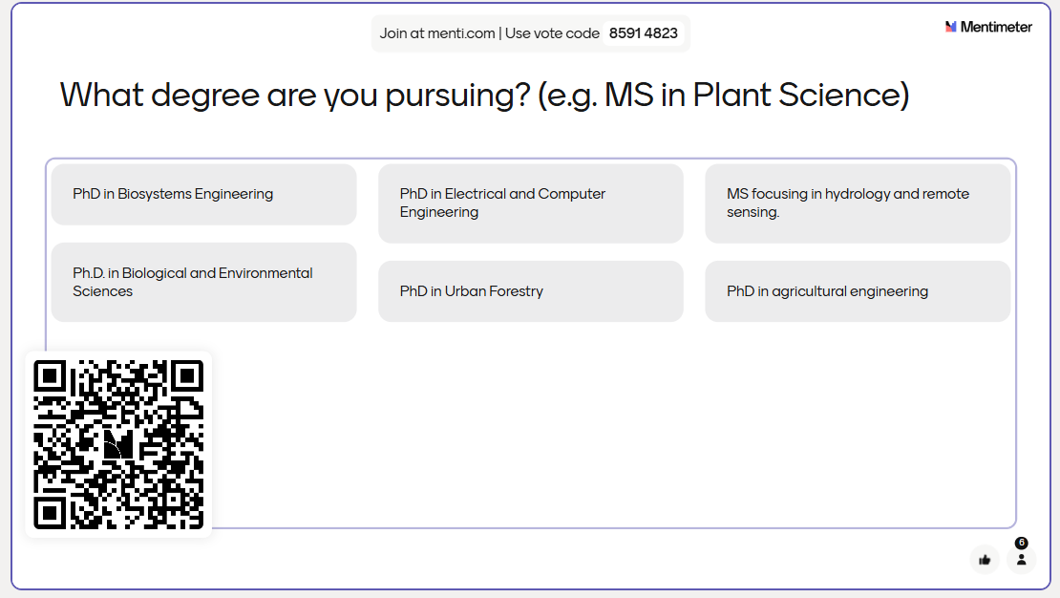


Slide 6
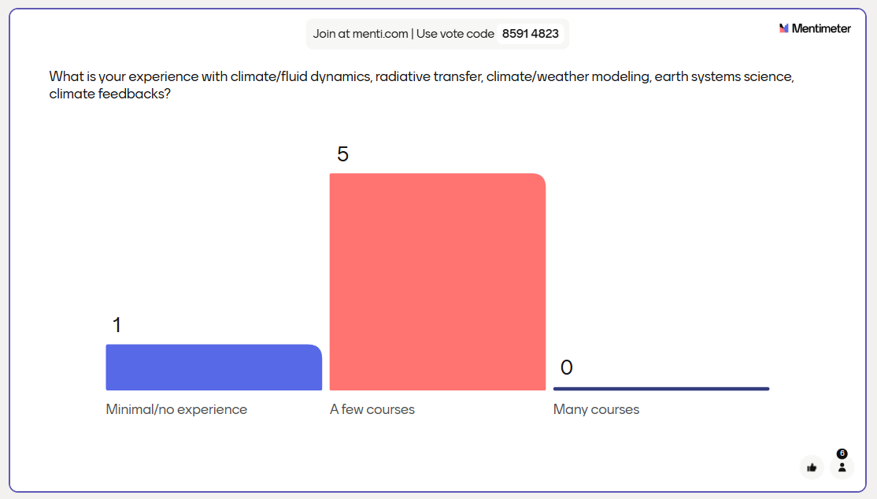
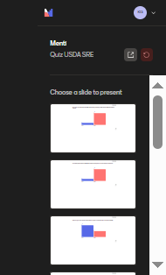

Slide 7
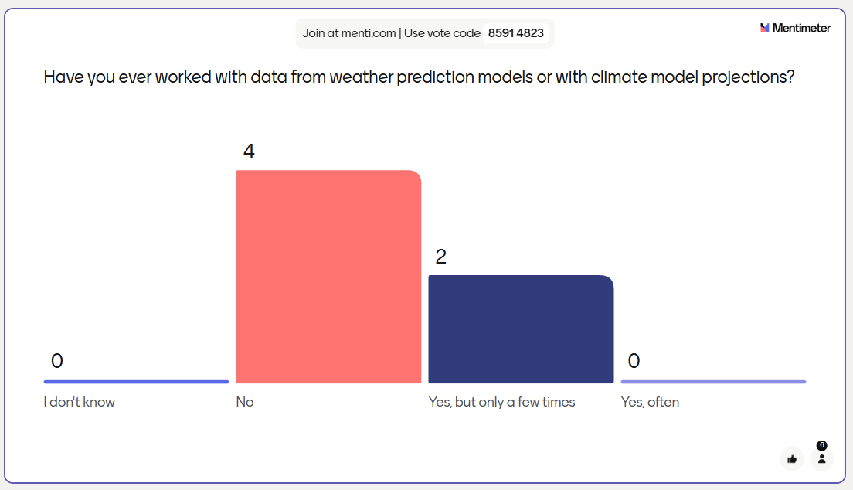


Slide 8
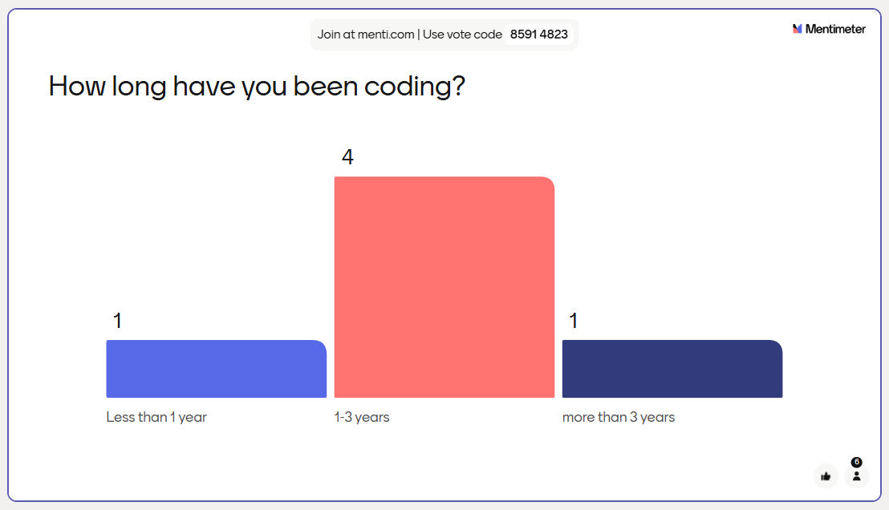
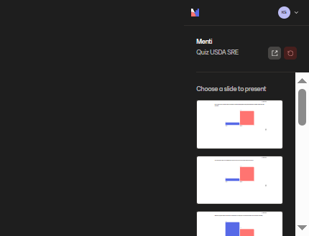

Slide 9
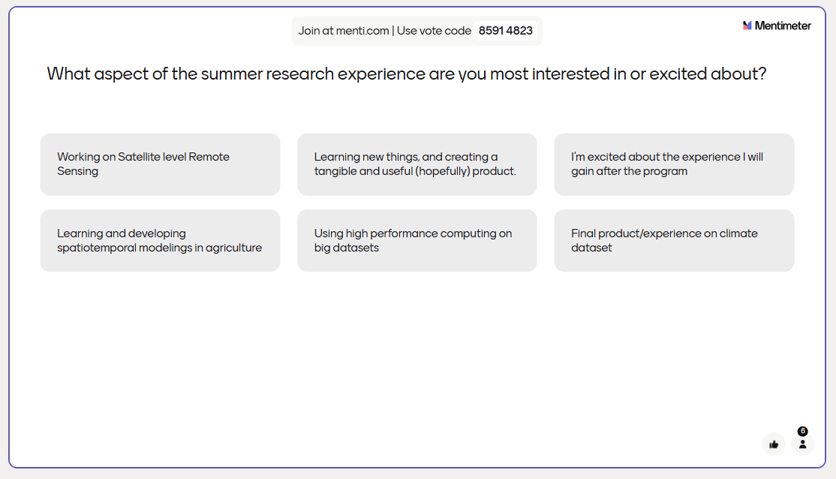


Slide 10
The Climate System

Slide 11
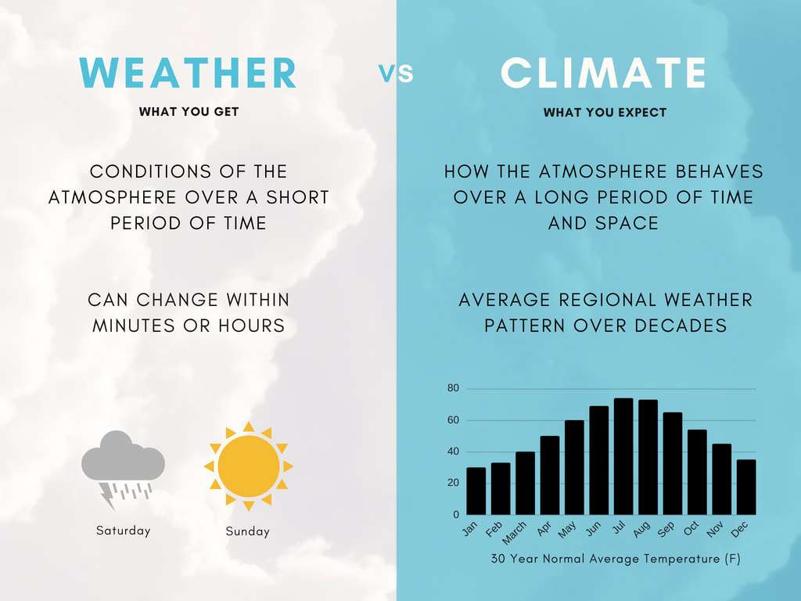
Weather Vs Climate
Notes:
Climate is what you expect, weather is what you get. Another idiom to explain the difference is that the weather determines the clothes you wear today, but the climate determines the type of clothes you keep in your wardrobe.
Weather is a short timescale phenomenon. In weather modeling, we use a lot of real world observations about the state of the atmosphere, ocean, and land surface and make predictions on how they will change over the course of a few days, or hour-by-hour, or even sub-hourly variations.
The climate of a particular region is determined by long-term averages of weather conditions. In climate modeling, we’re not concerned with predicting sequences of weather at all, instead the goal is to model how the earth system may behave decades in the future. The most important drivers of change in a climate model are things like aerosol content in the atmosphere, land use change, and most importantly GHG concentrations.

Slide 12
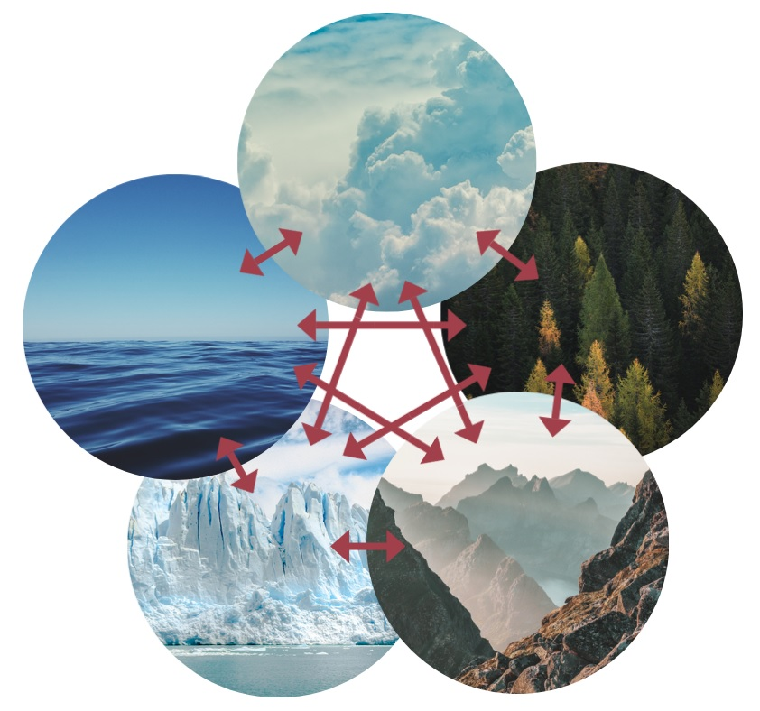
Components of the Climate System
Atmosphere
A climate model is a giant collection of code that includes submodels for components of the climate system.
Climate models use physical laws and equations on a 3D grid to produce simulations of climate from the past into the future.
Hydrosphere
Biosphere
Cryosphere
Lithosphere
Notes:
The global system consisting of five major components: the atmosphere, the hydrosphere, the cryosphere, the lithosphere and the biosphere and the interactions between them. The climate system changes in time due to fluctuations in the natural interactions between the climate components (this is called internal dynamics) and also because of external forcings such as solar variations, orbital forcing, volcanic eruptions, and anthropogenic forcings such as the changing composition of the atmosphere and land-use change.

Slide 13
Intro to Climate Modeling

Slide 14
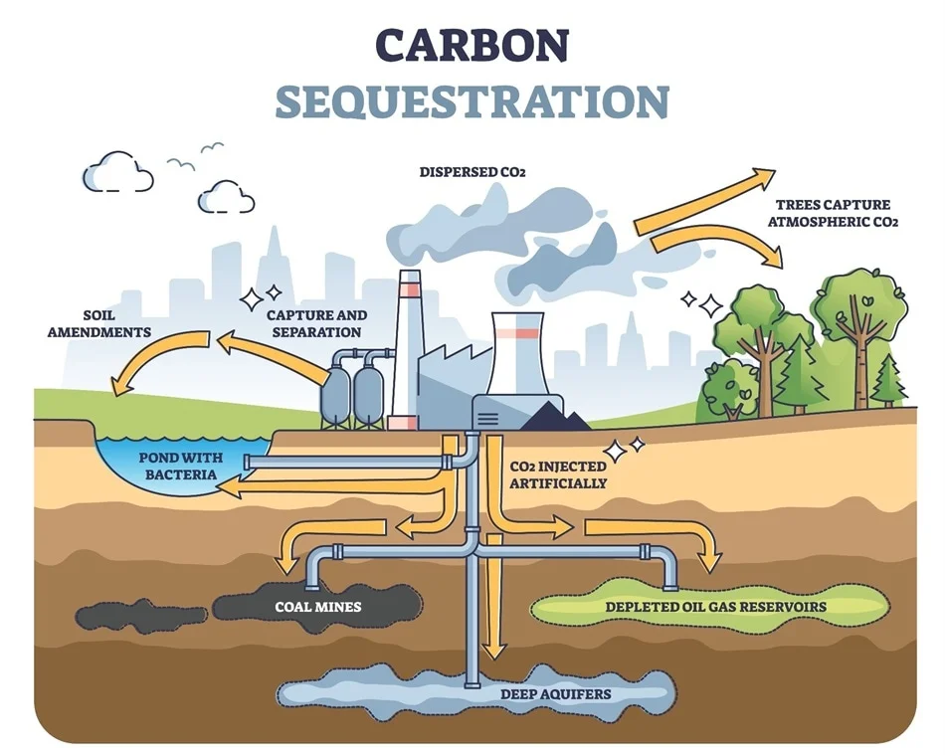

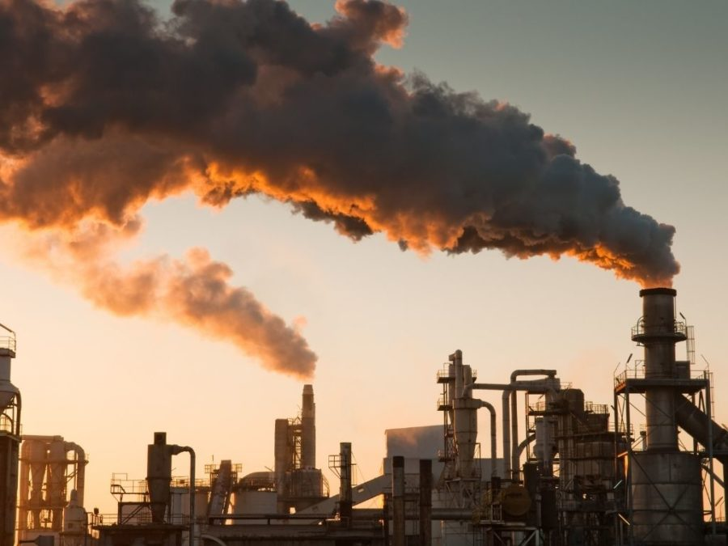
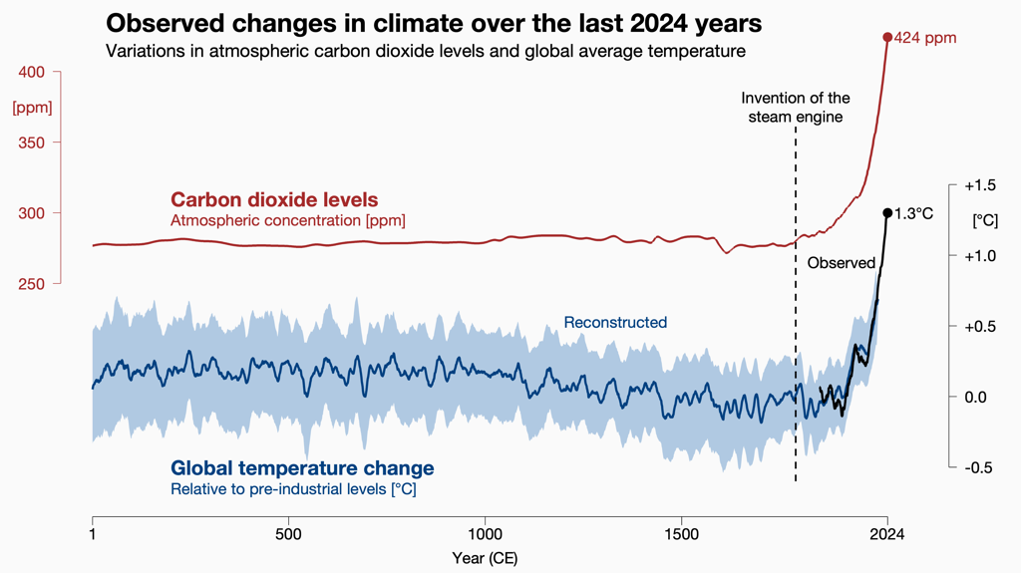
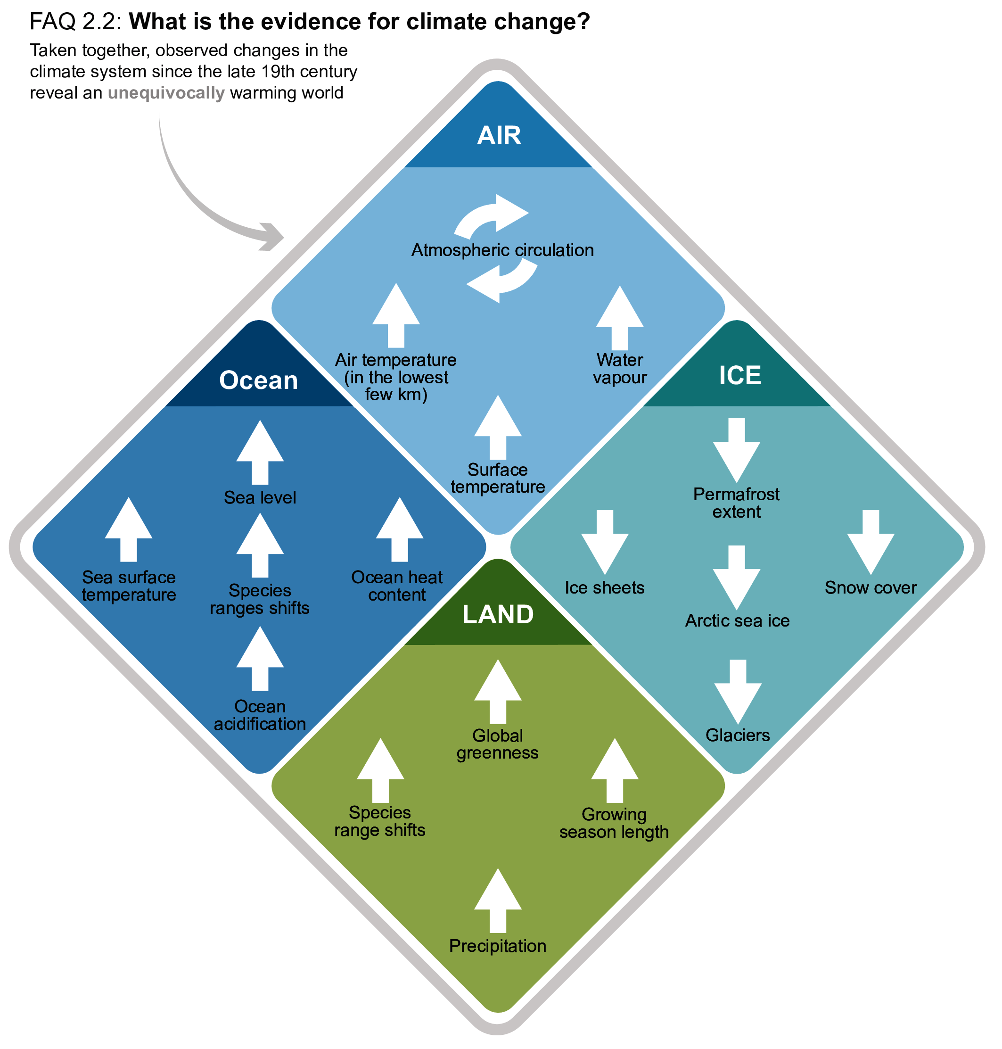

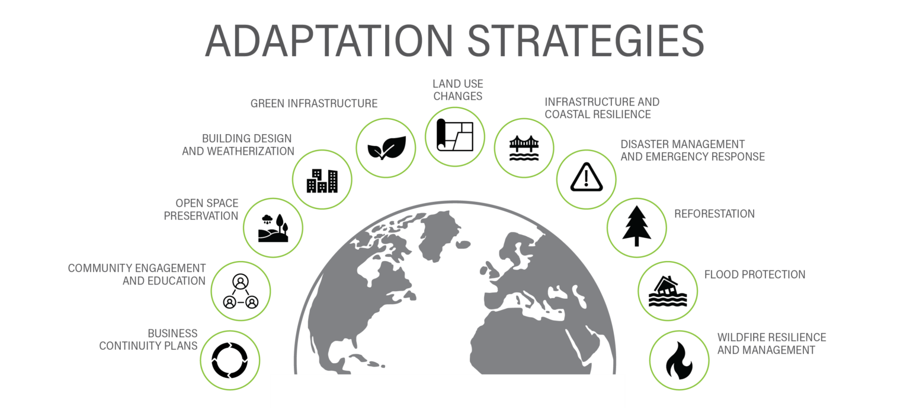
Why Does Climate Modeling Matter?
improve scientific understanding of dynamic climate processes
and changes to the climate system
inform planning, policy development, mitigation, and adaptation strategies
support litigation to hold polluters responsible for damages caused by climate change
Notes:
used to investigate aspects of our earth system to better understand dynamic processes
used to inform planning and policy development, mitigation and adaptation projects
used for attribution studies, how much worse are certain climate-related catastrophe’s now than if there had been no GHG emissions from oil and gas companies?, we’re talking like wildfire occurrences, sea level rise, extreme weather events. How much worse has climate change made a particular extreme weather event?
litigation. Attribution can go hand in hand with climate litigation. Suing those who are responsible for climate-related deaths and damages.

Slide 15
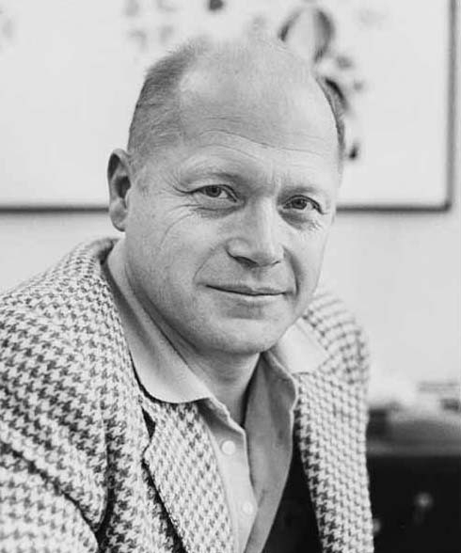
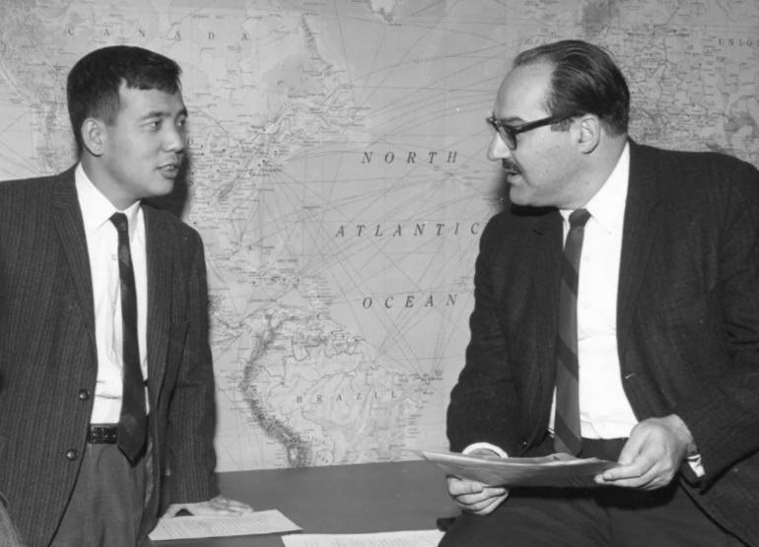

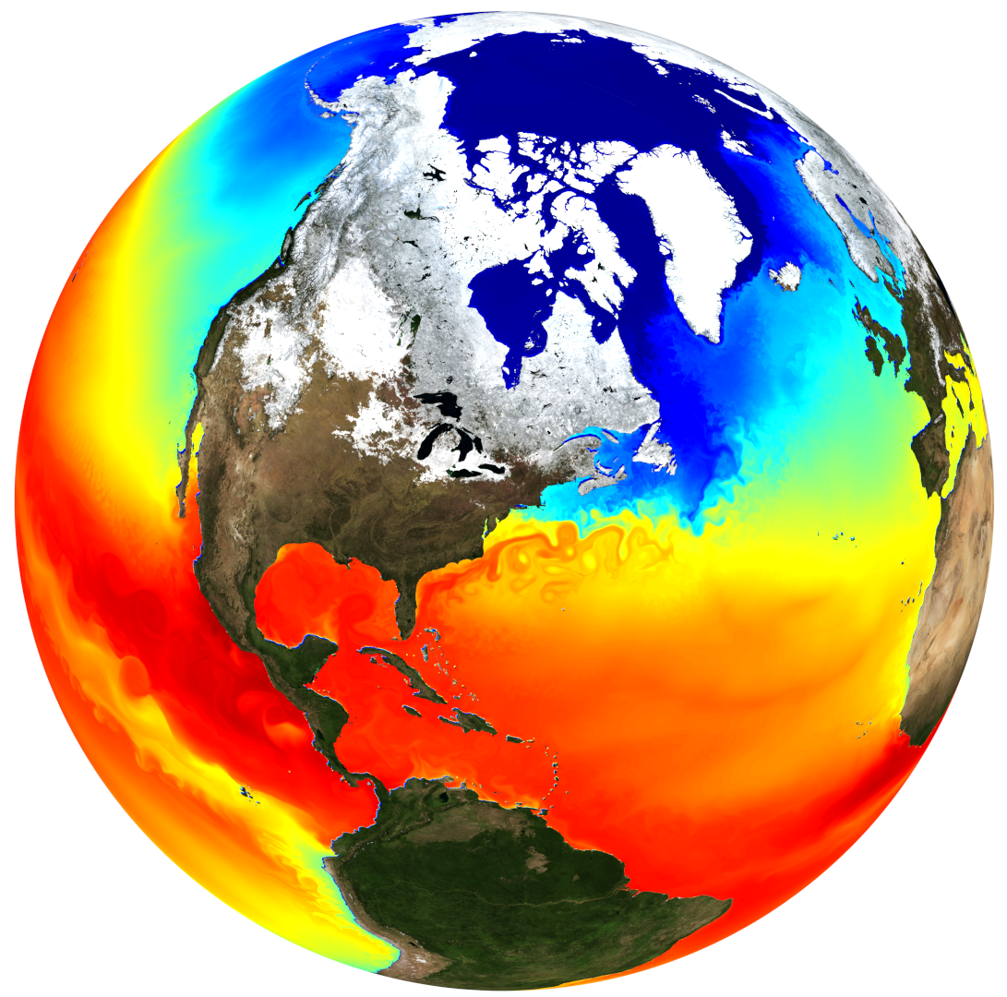
Climate Model Development
Huge Increases in Complexity and Realism
Major Development Driven By Increasing Computational Power
Numerical Modeling Begins
First Climate Model
Early 1950’s
1965
1970’s – 1990’s
2000’s – today
Models get more realistic
Spatial resolution continues to improve
More physical processes and climate system components: vegetation, more aerosols, ice sheets, carbon/nutrient cycling, atmospheric chemistry, detailed hydrologic cycle, and more
Recently, experimentation with ML/AI
Norman Phillips was the first to show that weather prediction with numerical models was even feasible.
At Princeton, he developed the first computer simulation of the atmosphere with a simple General Circulation model. His computer had 5 kilobytes of memory on the computer and 10 kilobytes of data storage to work with
Joseph Smagorinsky and Syukuro Manabe develop the first 3D general circulation model suitable for studying the Earth’s climate at Princeton’s GFDL. It has a 9-layer atmosphere, solves the primitive equations (fluid dynamics) on a sphere, and can simulate the basic structure of midlatitude storms.
Algorithm developments and resolution improvements as computation power increases
Coupled atmo-ocean models
Many more modeling centers
Inclusion of more physical processes and model components: land, more complex oceans, volcanism, aerosols
Notes:
First 3D climate model was an atmosphere model built at Princeton GFDL in the 1950’s and 1960’s. The scale of data they were working with was on the order of 10’s of kilobytes!
The early success of these models and the potential expected with higher computation power played a large role in investment in computing power and kicked off the exponential growth in computing
The earliest models simulated only the atmosphere and were mainly used for studying large-scale atmospheric circulation. Over time as computational power has increased, much more complexity has been added to these models, they now include many more aspects of the climate system, including the ocean, land surface, cryosphere, and even a complex representation of the carbon cycle that includes biological processes.

Slide 16
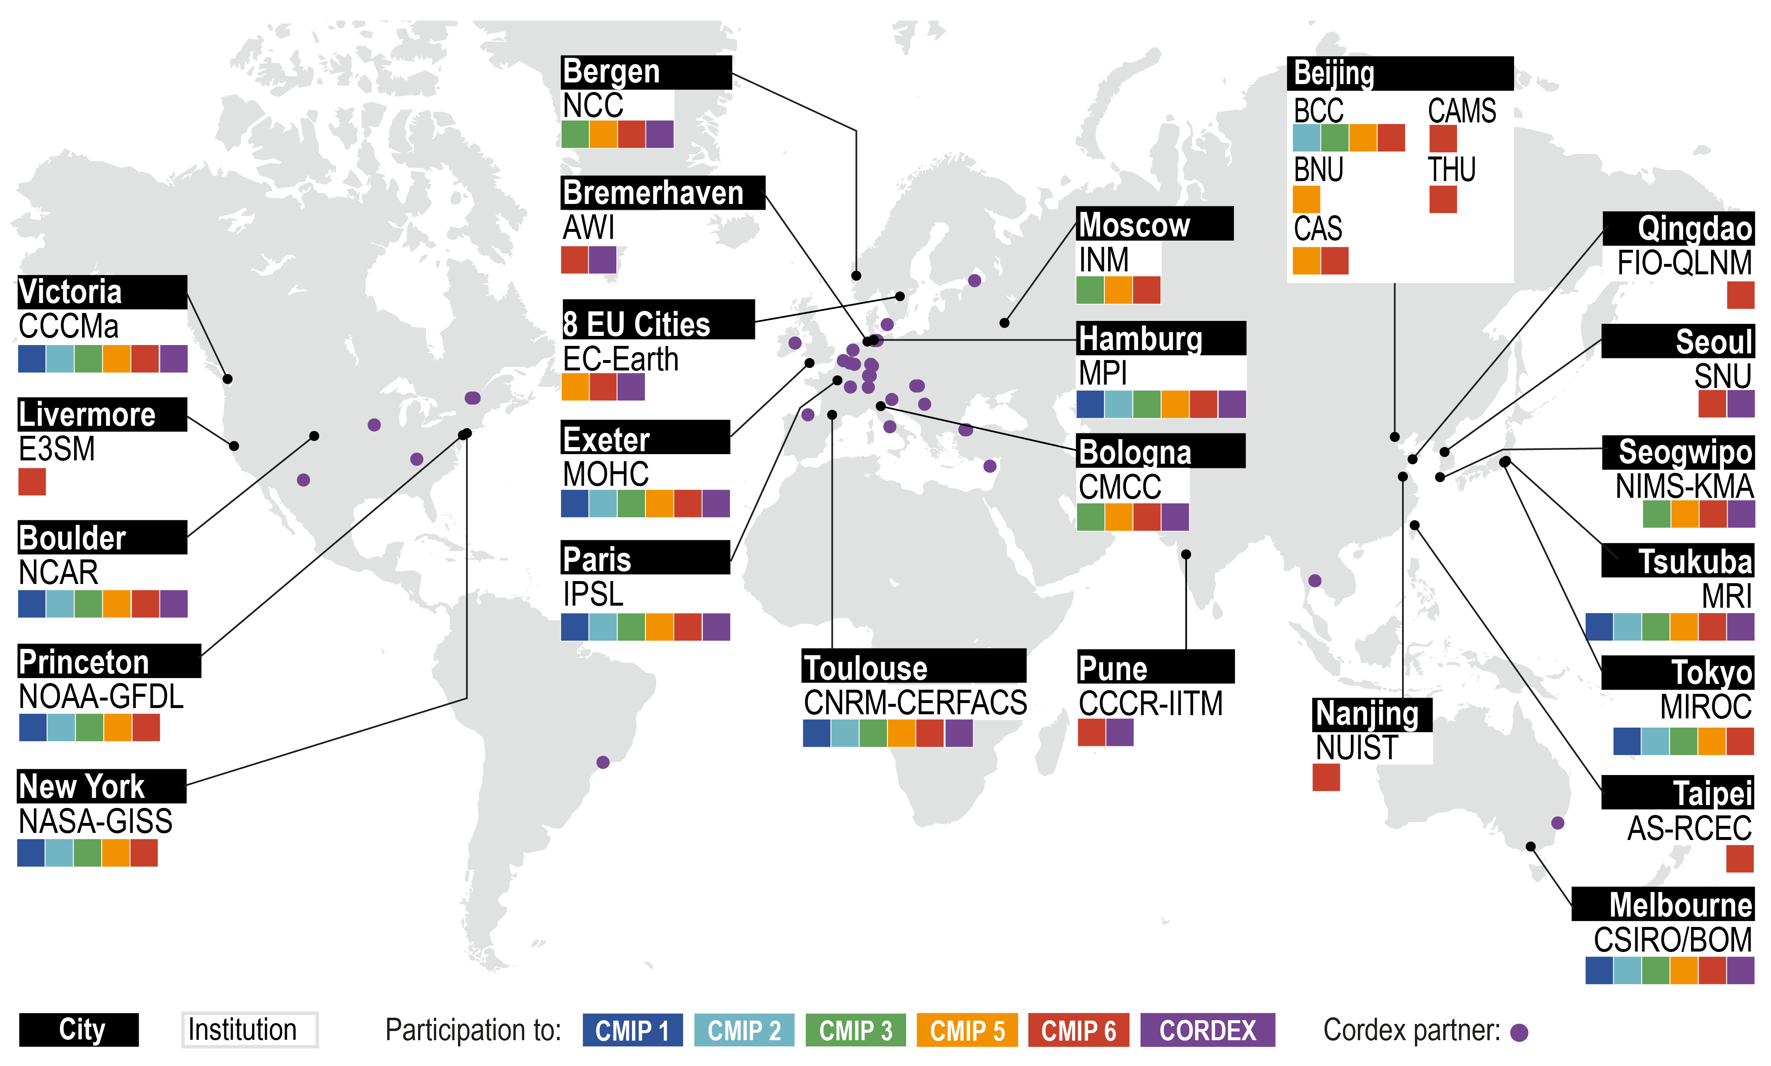
Today’s Climate
Model Developers
Notes:
Academic and government research institutions in countries around the world. We’ll talk about what CMIP and CORDEX are later but for now just know that these are different coordinated modeling projects over time where the yellow and red colors on here indicate more recent years and the blue colors indicate modeling centers that were active since the 90’s. And of course, some of these modeling centers were active well before that as we say on the previous slide.

Slide 17
Structure of a Climate Model & How They Work

Slide 18
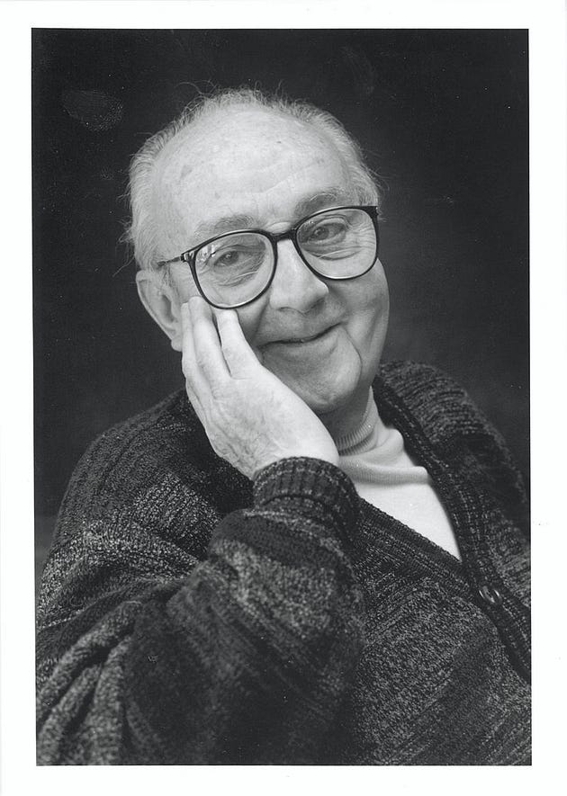
Get Into a Healthy Modeling Mindset
“All models are wrong
but some are useful”
- George E.P. Box
Notes:
Before we go any further, let’s get in to the right frame of mind. This quote should probably already be familiar to you. It’s important to keep in mind that no model can perfectly represent reality, but even imperfect models can be valuable for things like understanding complex systems as well as prediction. When we’re working in model land, we need to recognize that all models have their limitations and to have a health amount of skepticism and caution when interpreting their outputs.

Slide 19
Discretization
A climate model is a giant collection of code, that includes submodels for components of the climate system, tied to together
with a “coupler”. These models are discretized in space and time, calculating all the necessary quantities at each grid for a single time step and then moving onto the next time step.
Fundamental physical laws and equations, discretized on a 3D grid of Earth
Fluid Dynamics
Thermodynamics
Laws of Conservation
(mass, energy, momentum)
Notes:
Today’s climate models are generally somewhere around a million lines of code. We’ll see on the next slide how they’re organized into subcomponents that represent the components of the climate system and tied together by a central component called the coupler. These models discretize a 3D representation of the earth into grid boxes. The grid extends many layers up into the atmosphere as many layers down into the ocean. At each time step of a simulation, the model uses physics and math to calculate the value of hundreds of different variables at each grid box. There is vertical and horizontal exchange between grid boxes. Once all the necessary quantities are calculated the model moves on to the next time step and does the calculations again and so on and so

Slide 20
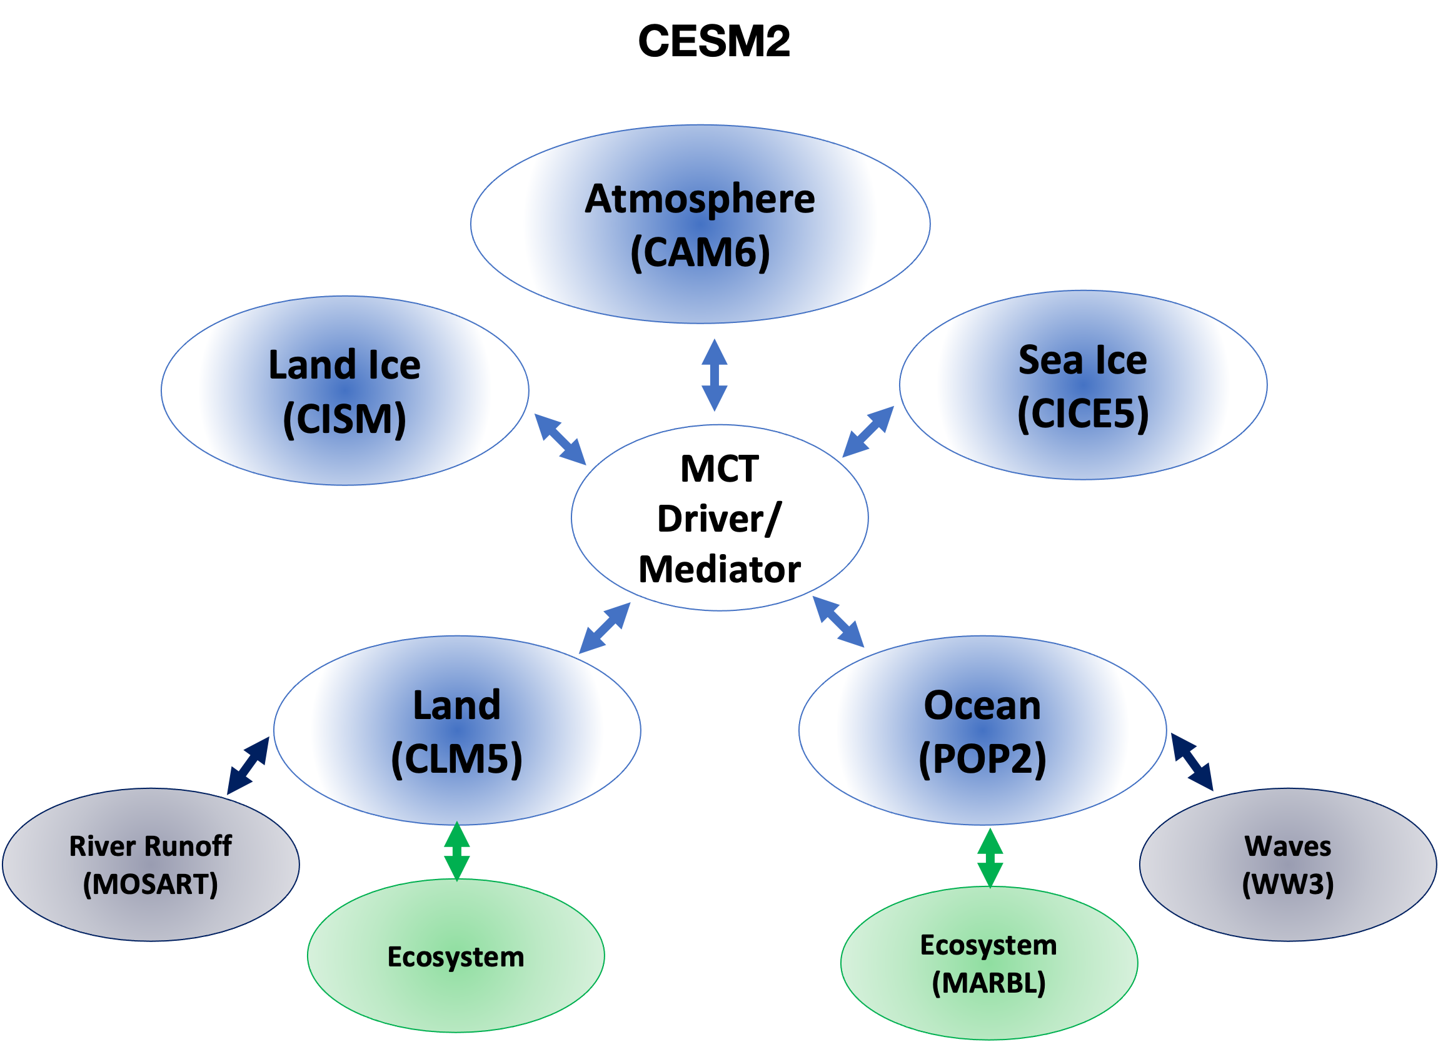
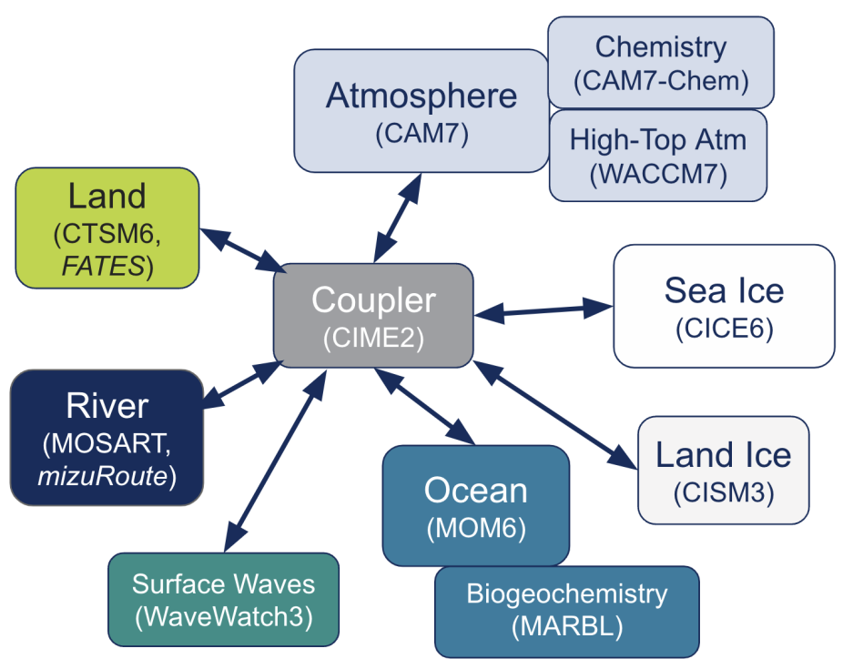
Climate Model Structure
Acronyms for global climate models:
GCM, CGCM, AOGCM, AGCM, ESM
Structure of climate models developed by the
National Center for Atmospheric Research (NCAR)
in the USA
CESM3
(currently under development)
(CIME)
Notes:
This is showing the structure of the community earth system model, the current generation (left) and the next generation model that’s under development (right).
These models are developed in the USA by NCAR in Boulder, Colorado which is funded in large part by the National Science Foundation.
You can see here how the different components of the climate system are contained in submodels which are all connected by a central component called a coupler. Some of the model components have their own subcomponents too.
In general, at each time step, there’s a bit of a sequence to how a climate model executes. Usually the atmospheric component executes first and sends information to the coupler.
Then the other components execute using the info about the atmosphere and send back their information to the coupler again before the model moves on to the next time step.
The coupler is responsible for transferring the relevant information from each component to the others and ensuring the entire simulated climate system is self-consistent.

Slide 21
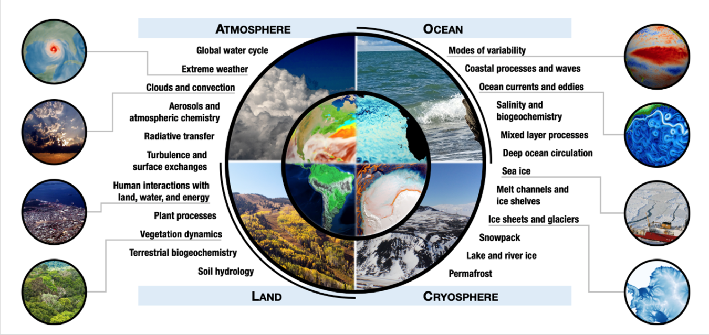
Processes in Components of a Climate Model
Notes:
Today’s climate models are very complex and simulate or approximate a ton of different processes. Climate models have weather patterns, ocean currents, clouds, hydrologic cycle, some of them have plant processes and a carbon cycle. Now, not all climate models do all these things and also this isn’t an exhausted list of processes either.

Slide 22
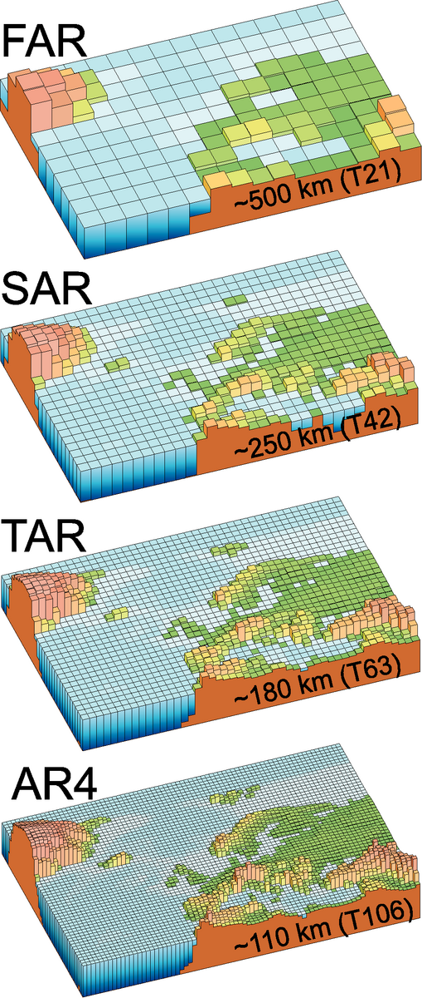
Grid Resolution & Computational Constraints
computational power is the main constraint on model resolution, with even fairly coarse climate simulations taking weeks to months to run on massive supercomputers
c. 1990
c. 1995
c. 2001
c. 2007
c. 2013
c. 2021
~60km but
most models
~110-330km
~25km but
most models
~110km
but most models
~200-400km
model grid resolution is the main constraint on which physical processes can be simulated directly and which need to be approximated because they occur on sub-grid scales
Notes:
these figures show the highest resolution atmosphere grid in climate models over the past few decades
this is a simplified view of the progression in the horizontal resolution tho since in general the ocean grid is twice the resolution of the atmosphere grid
the biggest constraint on model resolution is computational power
simulations of the entire globe for hundreds of years even at these lower resolutions takes weeks to months of run time on massive supercomputers
Today, computational power has progressed to the point where a few modeling centers now have unified modeling frameworks (UKMO) that can be used for both weather prediction which requires very high spatiotemporal resolution and climate projections. But this is not yet wide spread due to how long it takes to run high resolution global simulations.
Also, finer grid spacing actually requires a smaller time step for the models to remain stable. So the time it takes to run a simulation isn’t necessarily proportional to only the horizontal resolution since and increase in spatial resolution also requires and increase in temporal resolution as well

Slide 23
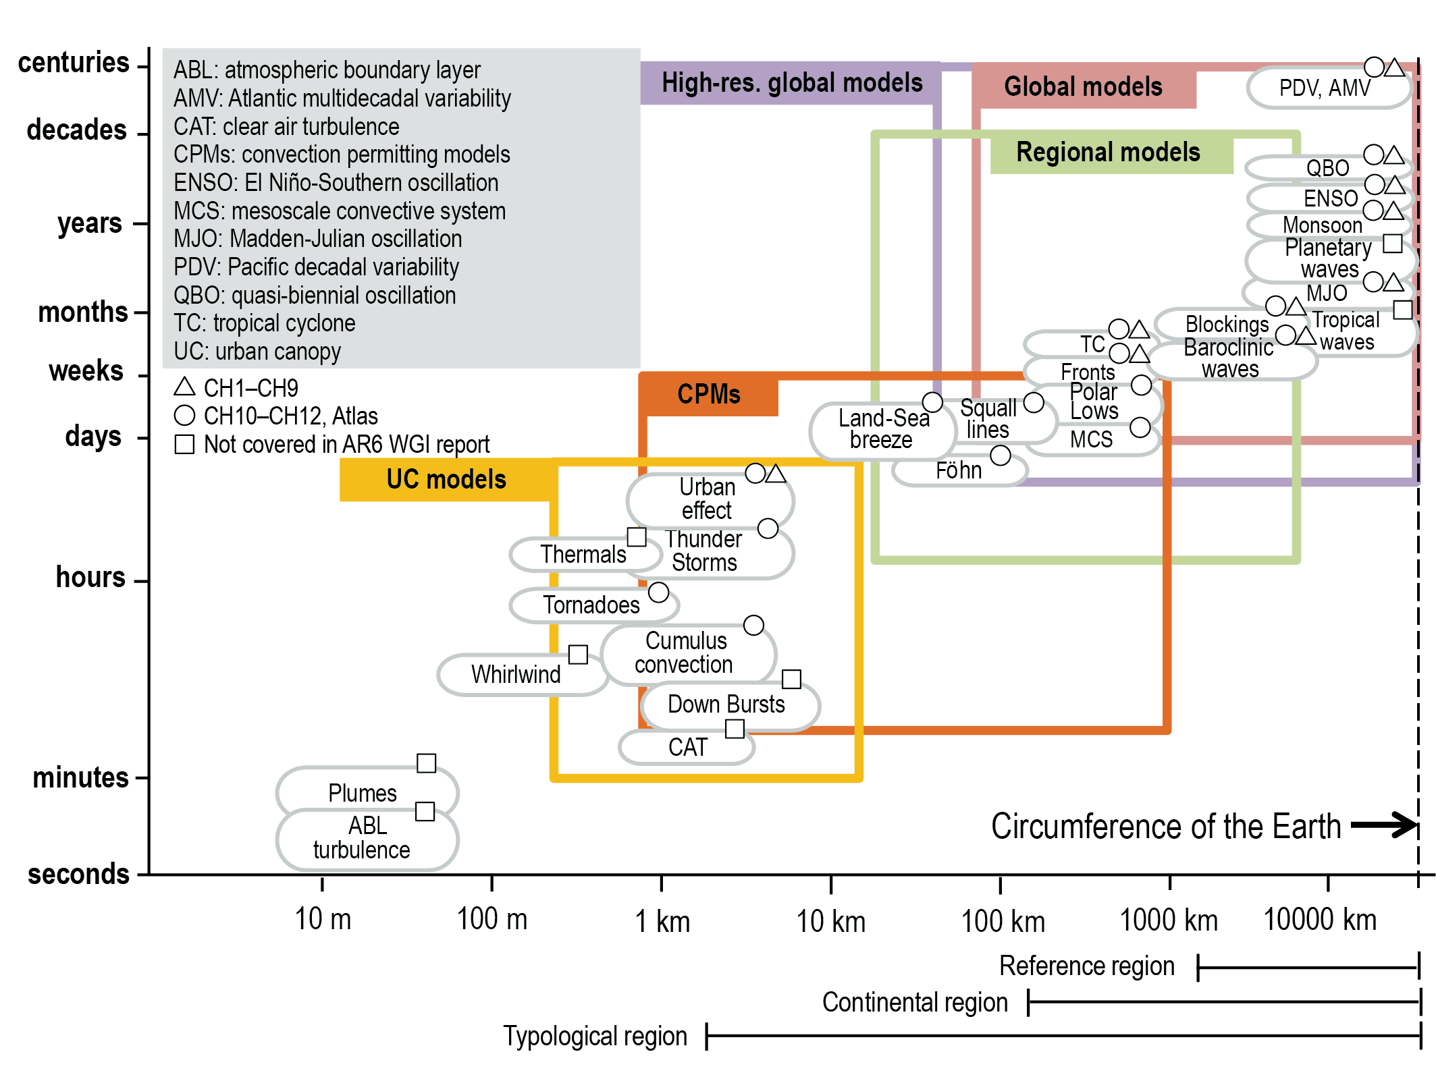
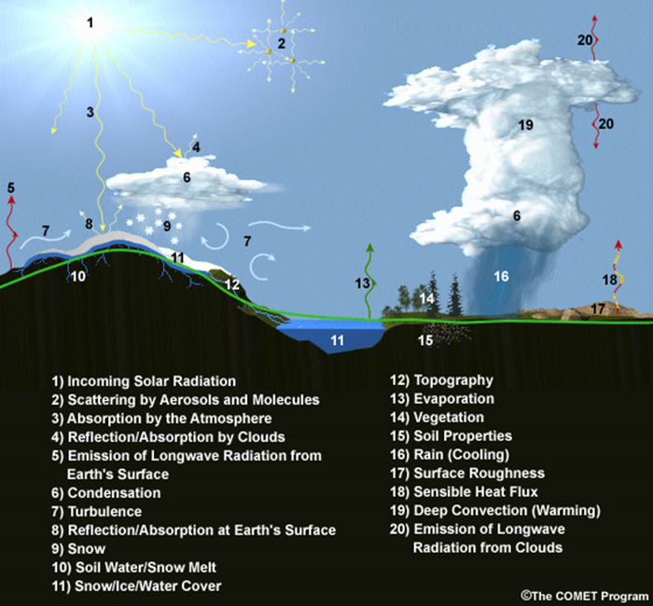
Parameterization
is the approximation of physical processes that are too small or complex to be explicitly simulated at the scale of the model grid
Notes:
- The climate system involves interactions between physical processes that act at very large scales to very small scales, as we heard Gavin Schmidt talk about.
Processes that can be accurately represented at the grid scale of a model we call “resolved”. Processes that are smaller than the grid scale we call “unresolved” or “sub-grid” processes. These are the processes that need to be “parameterized” which is the approximation of sub-grid scale processes.
This figure shows the types of processes that are resolved by models of different grid scales.
There are a lot of processes that are parameterized in climate models.

Slide 24
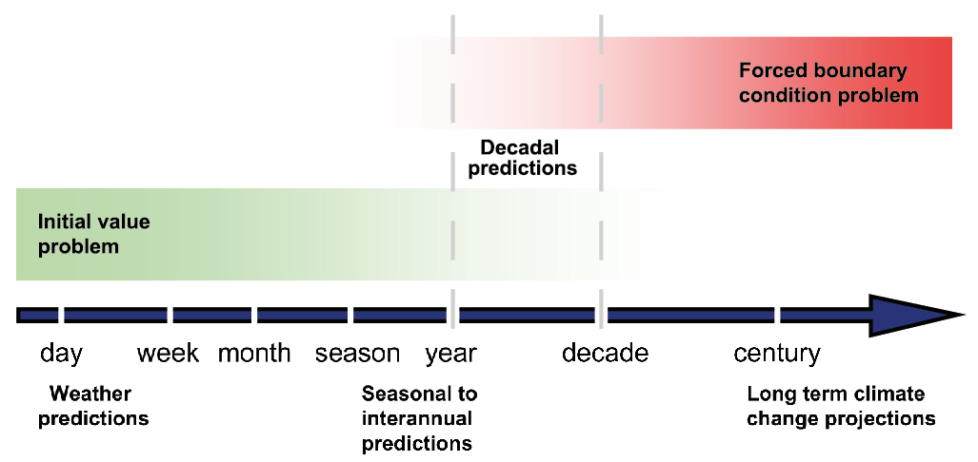
Weather Vs Climate Modeling
Weather Modeling
weather is chaotic
an accurate short-term forecast (hours to weeks) depends mostly on initial conditions (precise observations of the atmosphere, land surface, ocean at a point in time)
small differences in initial conditions quickly grow into large differences in the forecast
initial value problem
Climate Modeling
climate is dictated by long term tendencies
the particular sequence of weather patterns is irrelevant
we do not initialize climate models with real world data at a particular point in time
model results dictated by the external conditions applied (solar rad, GHGs, aerosols, land cover)
boundary value problem
Notes:
this is why there is a limit to predictability of the weather and forecasts only extend a week or two into the future
The word prediction implies we’re talking about short time scales and that real-world data initialization is important. We use the word prediction when talking about weather modeling.
The projection implies we’re talking about longer time scales and that external conditions are more important that initial values. We generally use the word projection when walking about climate modeling.

Slide 25
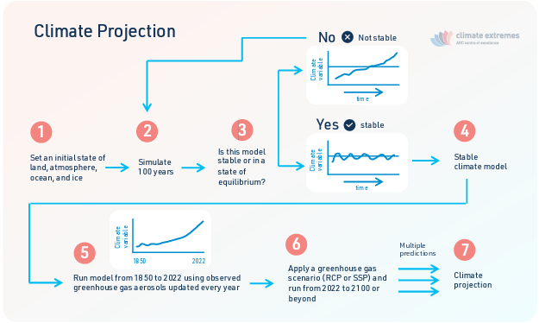
The Concept of Free-Running
once stable, year is set to 1850 but this does not correspond to real-world 1850
{
not real-world years
initialization
and spin-up
{
simulation with observed and projected forcings
there is no reason for natural variability in the model to align with real-world conditions in any given year or decade even because CLIMATE MODEL YEARS DO NOT CORRESPOND TO REAL-WORLD YEARS
Notes:
If climate models aren’t initialized with real world observations, then how are they initialized?

Slide 26
Coupled Model Intercomparison Projects (CMIP)

Slide 27
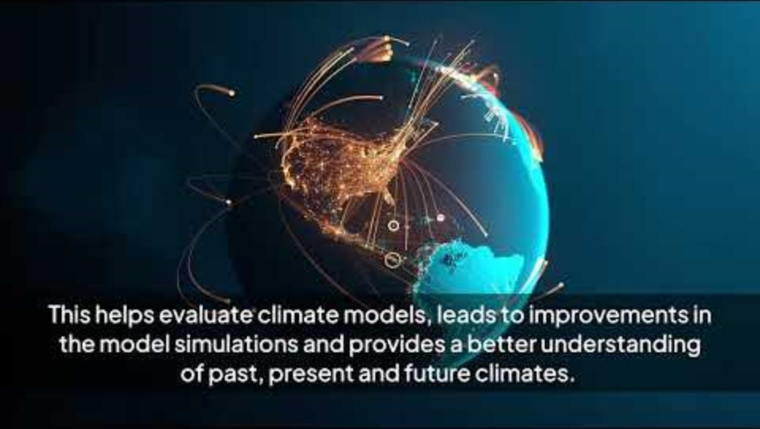

Slide 28
CMIP
Who? Climate modeling centers at universities and government agencies around the world
What? An ongoing international climate modeling project. All modeling centers participating in a CMIP use their climate models to run an agreed upon set of modeling experiments, using a common set of historical forcings, future scenarios, and metadata/naming standards.
When? New CMIP phases align with the timeline of the IPCC climate change reports → every 5-7 years. The design of CMIP7 is currently underway
Where? Model outputs are stored in a large archive hosted by the Earth System Grid Federation (ESGF), which allows data users to search comprehensively and download data held in various data centers around the world, for free.
Why? To better understand our climate system and how it is changing, and to support the ongoing assessments of climate change by the IPCC.

Slide 29
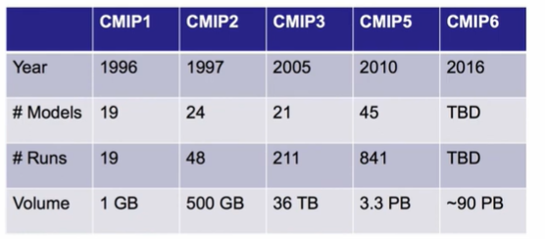
CMIP Data Growth
CMIP has grown into a big data problem that
requires large data downloads and storage space
requires expertise in coding and automated processing
reduces usability for non-specialists and for applications/decision support

Slide 30
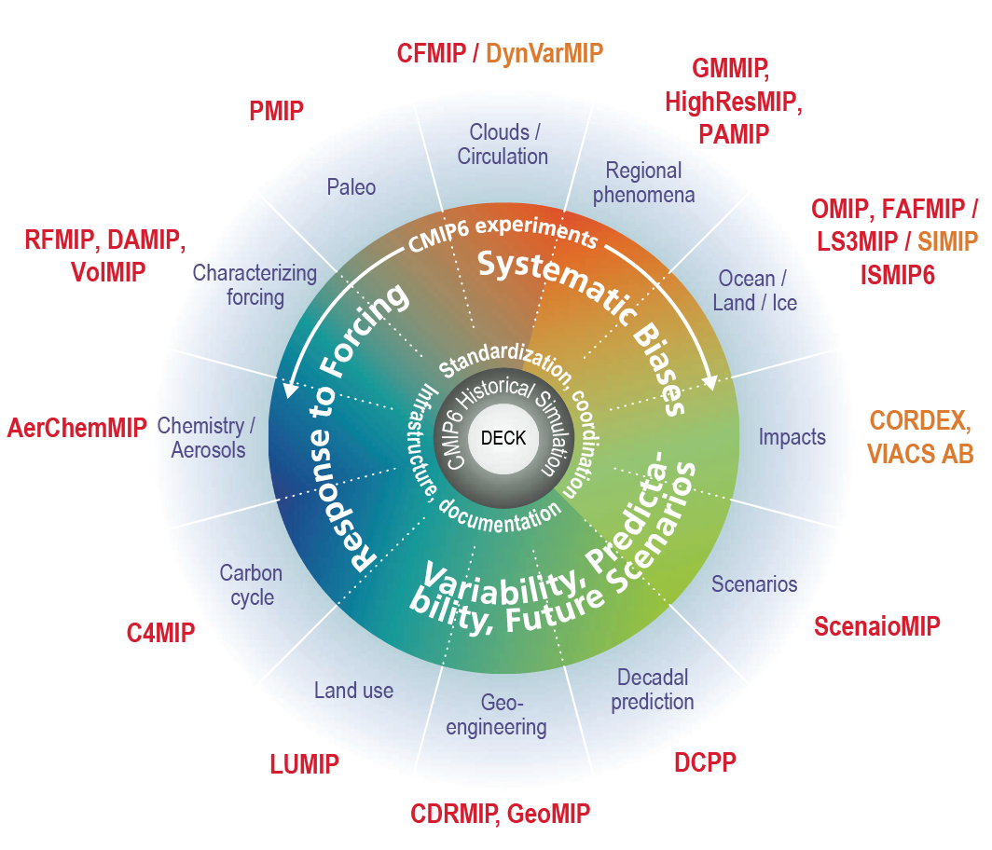
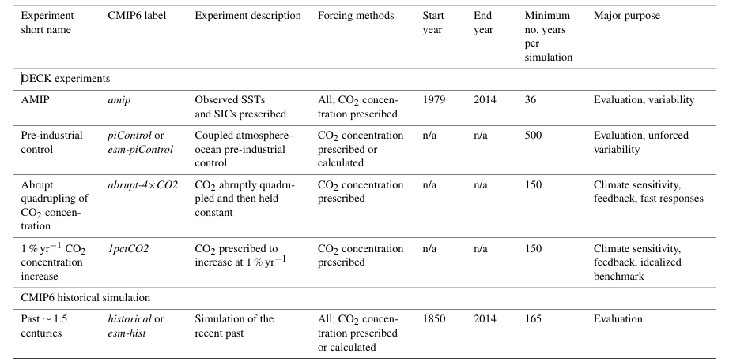
CMIP6 Experimental Design

Slide 31
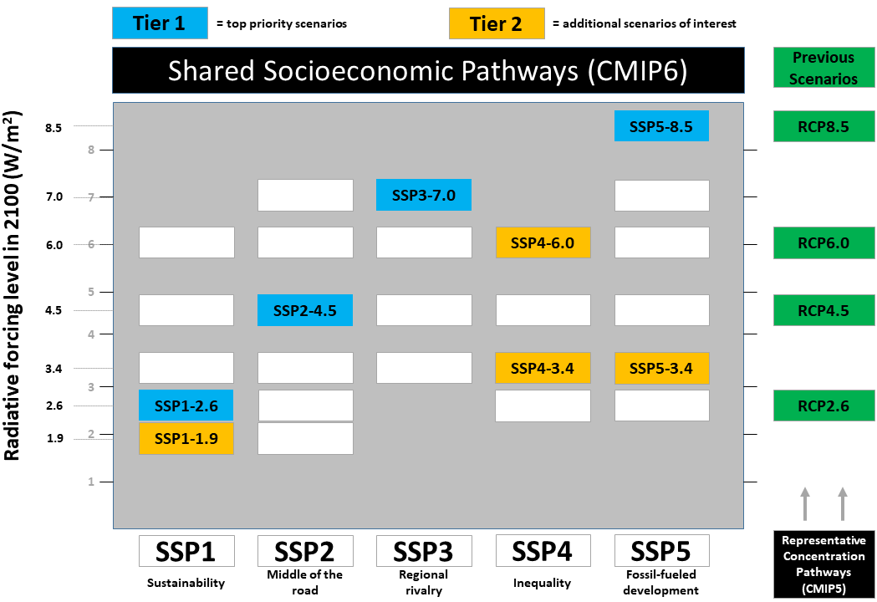
ScenarioMIP
Scenario | Brief Description
SSP1 | Sustainability: taking the green road (low challenges to mitigation and adaptation)
SSP2 | Middle of the road (medium challenges to mitigation and adaptation)
SSP3 | Regional rivalry: a rocky road (high challenges to mitigation and adaptation)
SSP4 | Inequality: a road divided (low challenges to mitigation, high challenges to adaptation)
SSP5 | Fossil-fueled development: taking the highway (high challenges to mitigation, low challenges to adaptation)
due to GHG concentrations, aerosols, land cover in each scenario

Slide 32
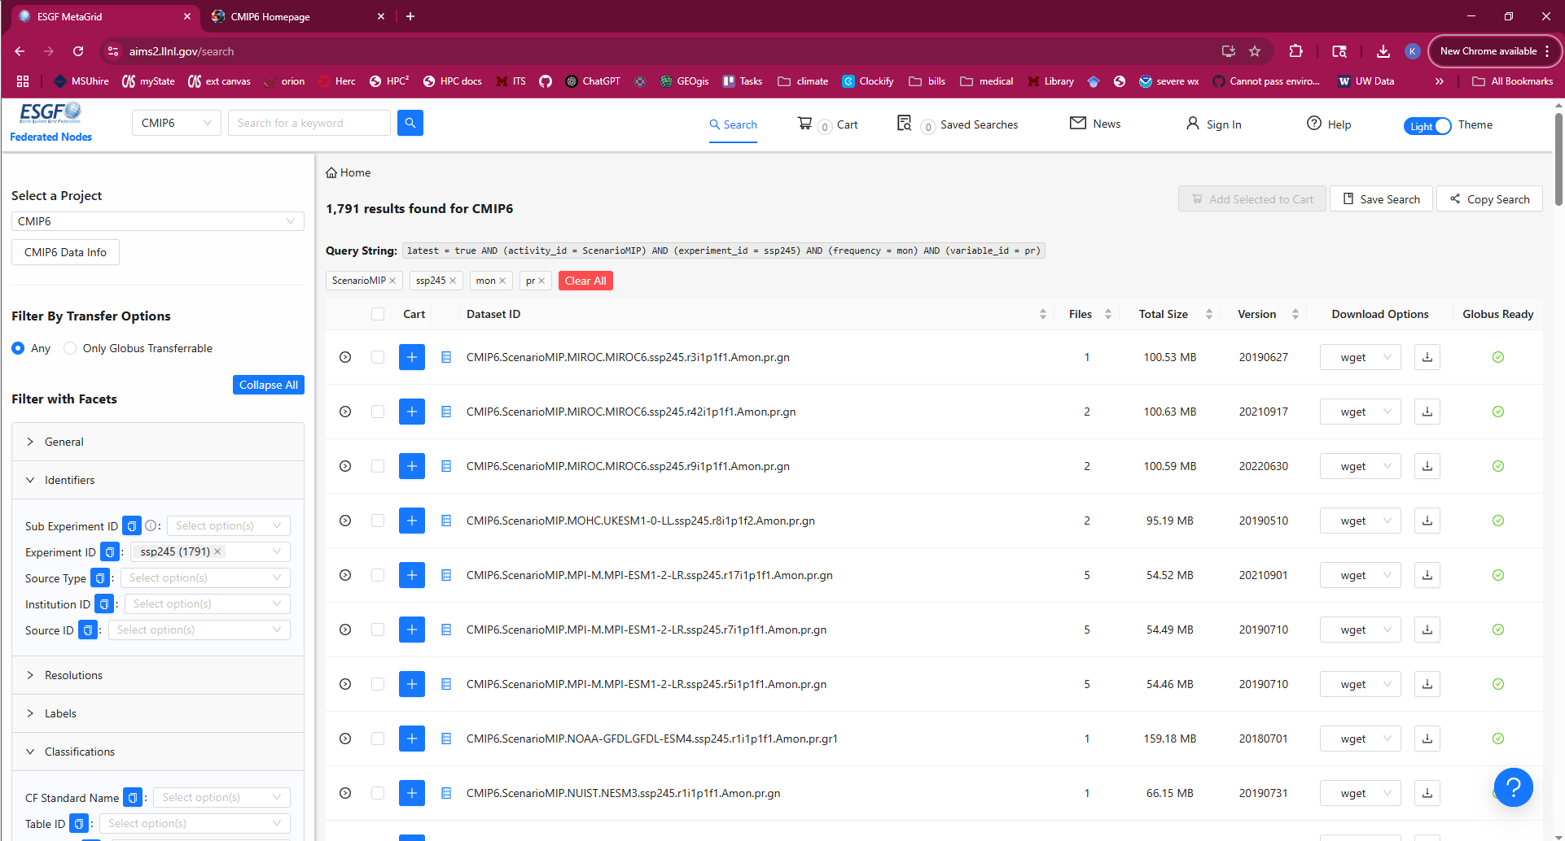


CMIP Data Access
CMIP Data Access
Landing Page
ESGF Data Search
shown here →

Slide 33
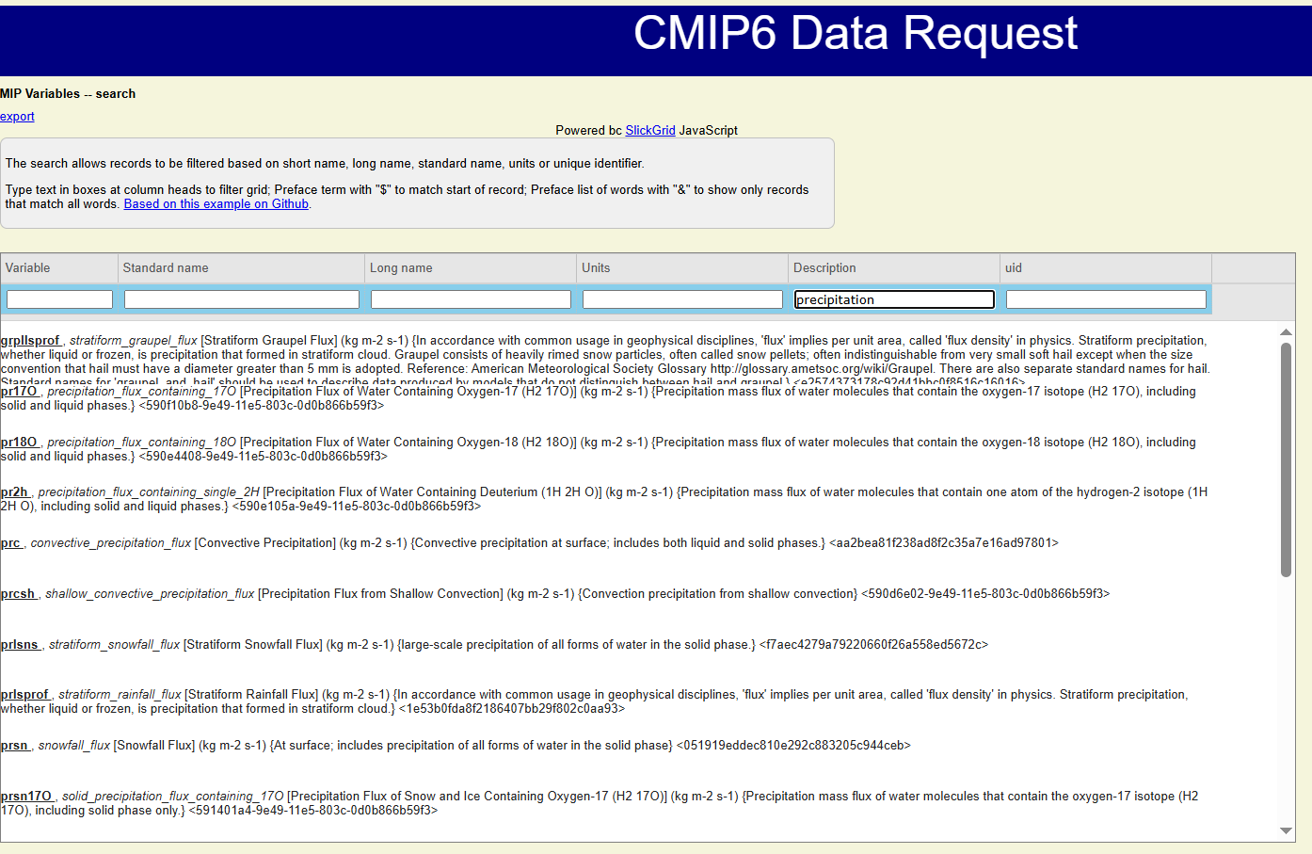

What variables are available?
CMIP archive contains hundreds, maybe thousands of different variables
not all variables are provided by each model
most variables are things you’d never use in an applied science application (pr2h [Precipitation Flux of Water Containing Deuterium], prlsns [Stratiform Rainfall Flux])
General climate variables like precipitation, air temperature at the surface and on pressure levels, pressure fields, wind components at the surface and on pressure levels, relative and specific humidity, sea surface temperature, snow
Monthly, daily, some sub-daily
netcdf files
The UK CEDA data service has a handy variable search

Slide 34
CMIP: An Ensemble of Opportunity
Not a formal statistical ensemble!
Any climate model can participate as long as they run the required simulations and follow the CMIP protocols
No performance requirements/benchmarks. Models have a large range of skill, from poor to excellent
Not all models are of the same complexity
Not all models generate the same output variables or at the same output frequencies
Not all models run all scenarios
MODELS ARE NOT ALL INDEPENDENT
Model grids can be very different
Model parameterizations can be very different
What are the implications?
There’s a paucity of transparent information about model skill
Specific documentation of model code can be hard to find or unavailable
Users should examine model skill before using model projections (compare to observations)
The exact reason(s) for differences between models can be difficult or impossible to know
The spread in model results does not represent the full range of uncertainty
It’s not a great idea to use the CMIP suite of models for probabilistic analyses

Slide 35
Sources of Uncertainty in Climate Modeling

Slide 36
Natural Climate Variability
fluctuations in the climate system that occur without human influence, arising from the complex internal dynamics of the Earth system and external natural factors
Internal examples
El Nino Southern Oscillation (ENSO): ~2-7 yr
Pacific Decadal Oscillation (PDO): ~20-30 yr
Atlantic Multidecadal Oscillation (AMO): ~60-80 yr
North Atlantic Oscillation (NAO): weeks to yrs
Arctic Oscillation (AO): days to months
Madden Julian Oscillation (MJO): 30-60 days
Like weather, internal variability is chaotic and less predictable than the effects of external forcing
External examples
Earth’s orbit and axis tilt (seasons)
solar cycles: ~11 years
volcanic eruptions: short term cooling (months to years)
asteroid/meteorite impacts: sudden short-lived cooling
Orbital Changes (Milankovitch Cycles): 20k-100k year cycles
Tectonic/geologic processes on geological time scales
For the same external forcing, there can be many possible realizations of internal variability
what may appear to be a real trend can simply be a result of fluctuations due to internal variability
multiple ensemble members of a single model can be used to quantify internal variability
and distinguish it from human caused changes in climate
“climate change detection”, “signal to noise”, “detecting the climate change signal”
uncertainty due to natural variability grows with finer spatiotemporal scales
i.e. climate change detection is more difficult at local scales

Slide 37
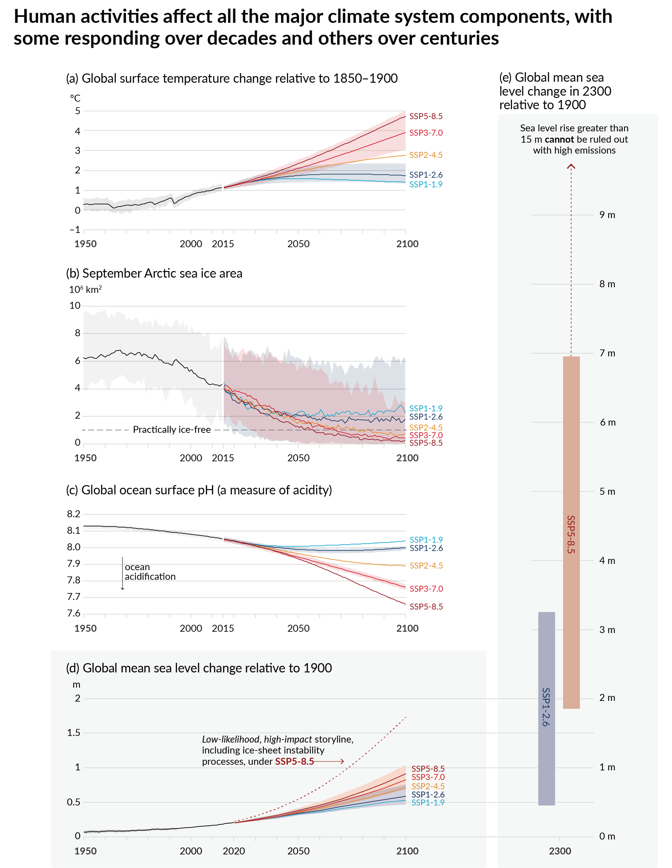
Model Uncertainty
also known as response uncertainty, for CMIP this is the spread of model results for a given radiative forcing
arising from the varying complexity and numerical differences between models and from structural uncertainty i.e. inadequacies within each model stemming from limited theoretical and observational understanding of some earth system processes, difficulty in mathematically describing known processes accurately, missing processes, and parameterized estimations

Slide 38
Scenario Uncertainty
which future pathway the world will follow in terms of society, economy, technology, and policy choices and how that will translate into climate forcing (GHGs, land use, aerosols)

Slide 39
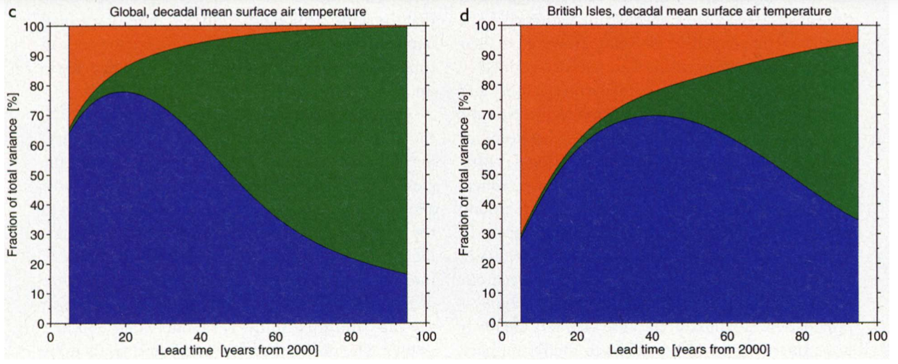
Relative Uncertainty at Different Spatiotemporal Scales
Internal Variability
Internal Variability
Scenario Uncertainty
Scenario Uncertainty
Model Uncertainty
Model Uncertainty
relative importance of sources of uncertainty changes with the time frame of the projection
natural fluctuations are relatively stronger and not averaged out at smaller spatial scales
Hawkins & Sutton 2009

Slide 40
Model Performance

Slide 41
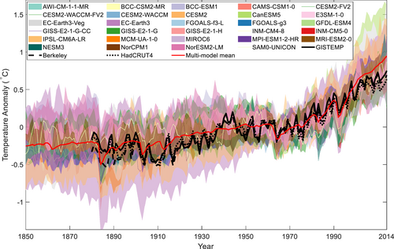
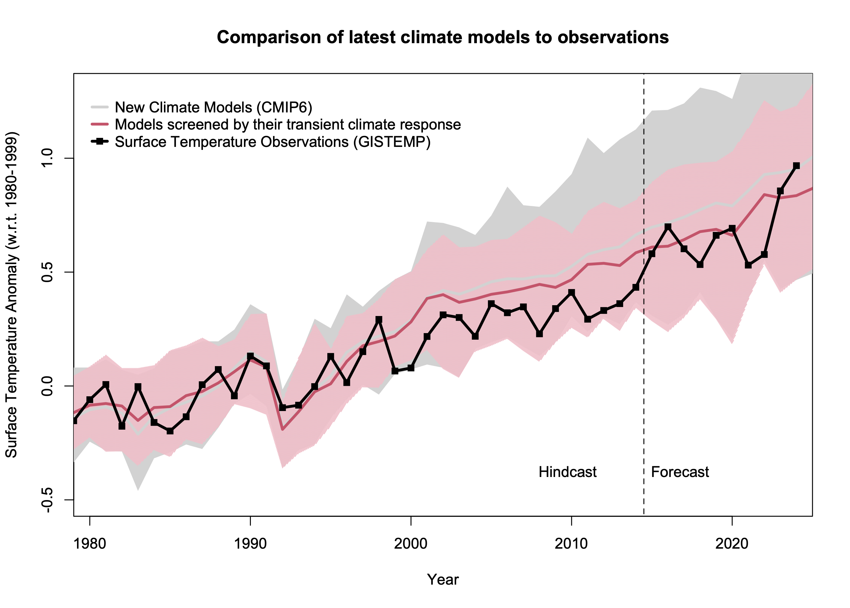
Climate Model Performance: Global Scale, Annual Scale

Slide 42
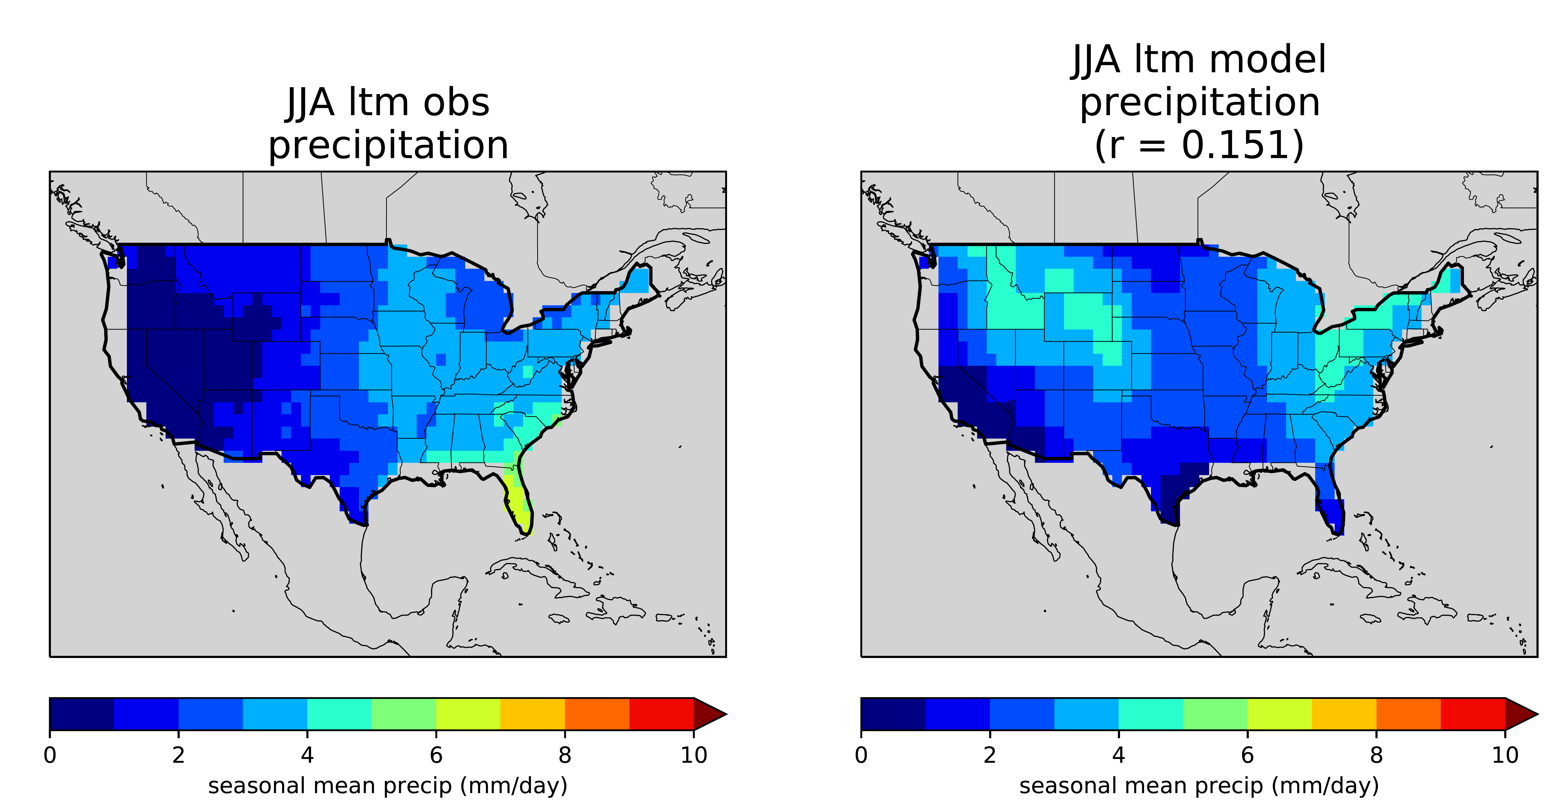
Climate Model Performance: Regional Scale, Seasonal Scale
Summer (JJA) long term mean (1906-2005) precipitation
MODEL MINUS OBSERVATIONS
NOAA GPCC
CMIP5
PR OBSERVATIONS
MODEL = MIROC-ESM
r = 0.151
3.5 – 14 inches
too wet
3.5 – 10.5 inches
too dry

Slide 43
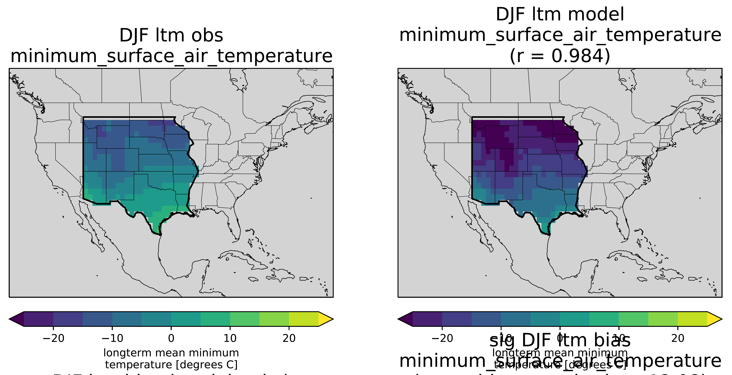
Climate Model Performance: Regional Scale, Seasonal Scale
Winter (DJF) long term mean (1906-2005) minimum surface air temperature
BERKELEY EARTH
CMIP5
TMIN OBSERVATIONS
MODEL = IPSL-CM5B-LR
~12°C (>20 °F) too cold on average
this is a major bias that will affect many other variables in the model
for example, frozen ground and snow instead of rain
degrees C
degrees C

Slide 44
Climate Model Performance: Regional Scale, Seasonal Scale
linear trend (1906-2005) in winter mean (DJF) maximum air surface temperature
BERKELEY EARTH
CMIP5
MODEL 100-YR TREND REVERSALS
OBSERVATIONS
MODEL = HadGEM2-CC
100-yr trend in DJF tmax (C/century)

Slide 45
Downscaled Datasets

Slide 46
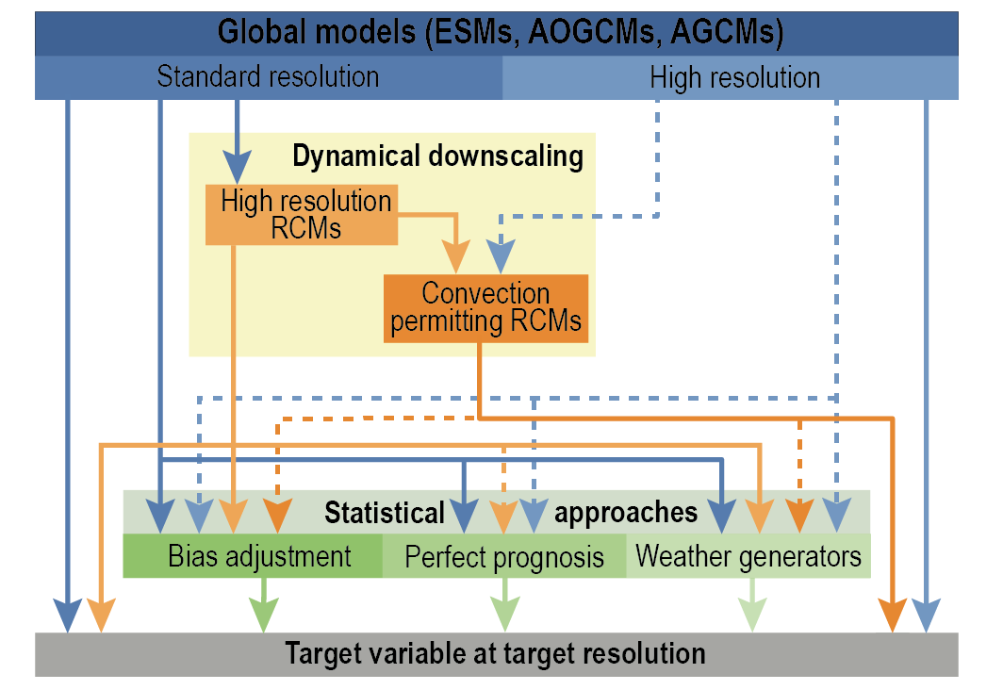
What is Downscaling?
The process of generating finer spatial resolution data from coarser resolution global climate model data. The goal is to better represent local change that isn’t resolved on the coarse global model grids.
Dynamical Downscaling: simulations run with a high res regional climate model forced with global model data
Statistical Downscaling: various statistical methods to find relationships between coarser model fields and high res gridded observations, then applying those relationships to model projections

Slide 47
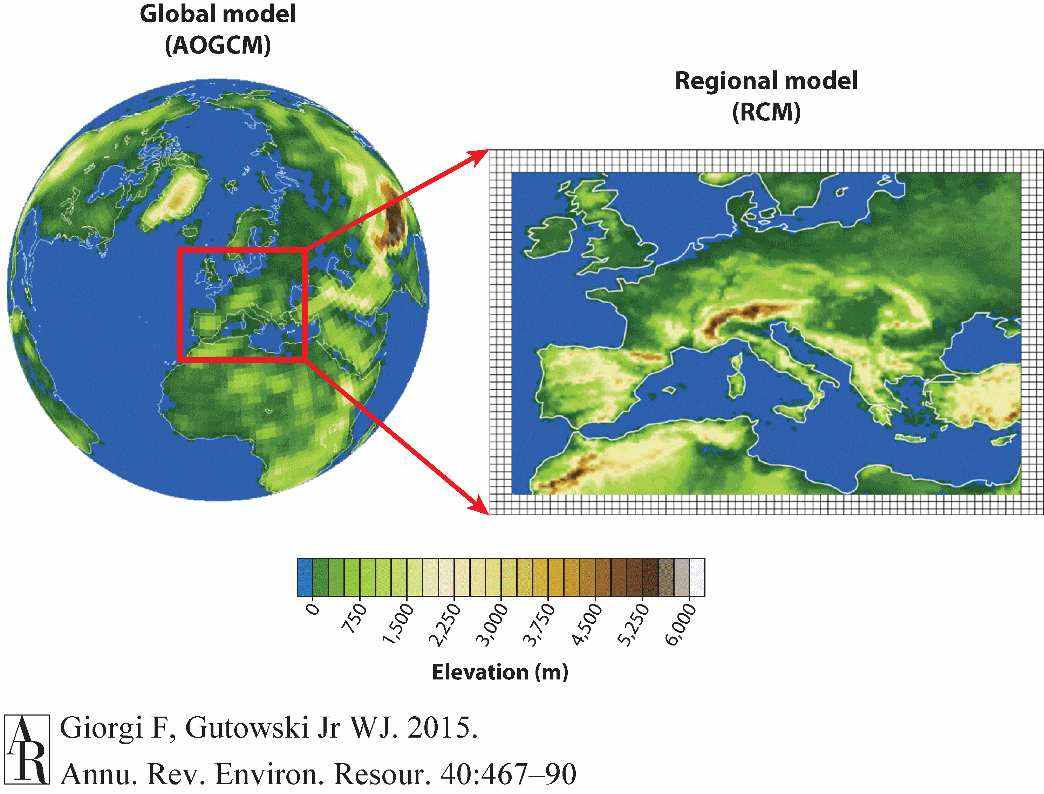
Dynamical Downscaling
Things to Know
Global model provides the boundary forcing
Global model bias correction
Inside the domain the simulation can be “nudged” to be more like the global model or not
Variables like precipitation come entirely from the regional model
Computationally intensive, especially for larger domains
produces physically consistent/coupled variables

Slide 48
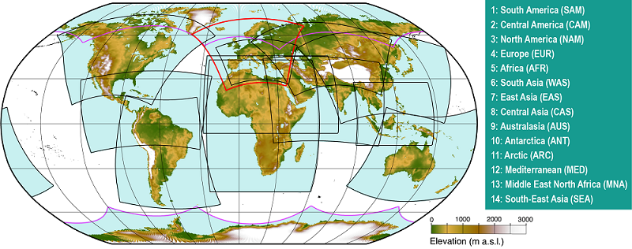
Dynamical Downscaling: CORDEX CMIP6
14 domains
12.5-25km target for horizontal resolution
Different driver RCMs and RCM/GCM combos
Not all GCMs downscaled
Big lag in data generation behind CMIP

Slide 49
Statistical Downscaling
Things to Know
Absolutely no method of bias correction can remove all model bias.
A climate model is a closed system where variables are calculated simultaneously based on physical laws. Applying statistical adjustments to variables can break physical consistency between variables
Statistical downscaling generally does not account for non-stationarity of the climate system (the statistical properties of the climate and the relationships between climate variables are changing over time)
There are a ton of different statistical downscaling and bias correction methods
Not a lot of information is available about which downscaling techniques are better or more appropriate for which types of applications
Generally, no benchmarking of CMIP inputs for downscaled datasets (bad models are downscaled too, do you want to use bias corrected projections from a horrible CMIP model?)
How does it work (in general)?
Always need high resolution gridded observations
Global models are bias corrected over the historical period, meaning that the model data is statistically adjusted to match observations at a coarse scale. The same bias correction is applied to the model’s projections.
Statistical models are developed to describe the relationships between large-scale variables and local variables.
These statistical models are then applied to the global climate model projections to generate high resolution data.

Slide 50

CMIP and Downscaled CMIP Datasets (not exhaustive)
CMIP Global Climate Model Simulations
CMIP3
CMIP5
CMIP6
WorldClim
delta method
SCRIPPS
LOCA
Downscaled Climate & Hydrology Projections
bias correction with spatial disaggregation + VIC land surface model for hydro variables
BCSD Downscaled Climate & Hydrology Projections
bias correction with spatial disaggregation (BCSD) + VIC land surface model for hydro variables
Downscaled Climate & Hydrology Projections
localized constructed analogs (LOCA) + VIC land surface model for hydro variables
NEX-GDDP-CMIP6
BCSD
AdaptWest/ClimateNA
delta method
Downscaled Climate & Hydrology Projections
bias correction with constructed analogs + VIC land surface model for hydro variables
BCCA Downscaled Climate & Hydrology Projections
bias correction with constructed analogs (BCCA) + VIC land surface model for hydro variables
NCAR NARCCAP
dynamic downscaling using regional climate models
Higher Res Downscaled Products
(Regional, Based on Global Climate Model Simulations)
in progress
UCLA WRF
dynamic downscaling using WRF regional climate model
WCRP CORDEX
dynamic downscaling using regional climate models
CGIAR-CCAFS
delta method
CGIAR-CCAFS
delta method
WorldClim
delta method
DDRegClim
dynamic downscaling using RegCM3 regional climate model
in progress
WCRP CORDEX
dynamic downscaling using regional climate models
UAlberta ClimateNA
delta method
NEX-DCP30
BCSD
MACA
multivariate adaptive constructed analogs
MANY
more to come

Slide 51
Model Evaluation & Ethics

Slide 52
The Practitioner’s Dilemma
What climate data do you use for a given project, application, or real-world decision?
Constant proliferation of freely available climate data that ranges in quality
CMIP model data
High-resolution downscaled data produced from CMIP models
Many observational datasets too
Not a lot of CMIP model skill information available, not easy to quickly judge data quality
Not easy to find guidance on which data to use for which application
Who is responsible for ensuring data is high quality and fit-for-purpose?
YOU ARE

Slide 53
Model Evaluation & Selecting Model Projections
develop relevant performance metrics
choose relevant evaluation area
choose observational datasets
get CMIP historical simulations
use metrics to compare CMIP to observations
evaluate CMIP models against observations in the context of your project
potential methods:
throw away the worst performers, OR
choose the 5-10 best performers, OR
select only simulations that meet a set of performance thresholds, OR
apply a weighting scheme, OR
some other defensible method
COARSER-SCALE APPLICATIONS (>~25km): stick w/CMIP projections
FINER-SCALE APPLICATIONS: choose models from a downscaled dataset (or multiple datasets)
Constraints on dataset choice:
spatial and temporal scale
available model quantities
robustness of downscaling technique for region of interest
availability of realistic models (according to your metrics)
parse good from bad
obtain projections
Important! There isn’t a one-size-fits-all answer to which models/products are “best” to use. It is application specific.

Slide 54
Your Responsibility as a Data User (and as an ethical scientist)
Your goal: the information you produce is defensible. Be able to defend all your choices regarding which data, models, statistics, and analysis methods you use
Tips for working with climate model data
search the scientific literature first for skill assessments that may be relevant to you
don’t just grab all model data and use the multi-model mean
always check if the models you’re using can realistically simulate whatever is relevant to your project
don’t just evaluate model skill at simulating mean climate, look at variability and possibly trends too
use more than one source of observations if available
write down all the choices you make throughout your project and note your reasoning
be as transparent as possible about your choices and quantify/communicate data uncertainty
be aware that decisions made based on your analysis with climate projections can affect lives and livelihoods

Slide 55
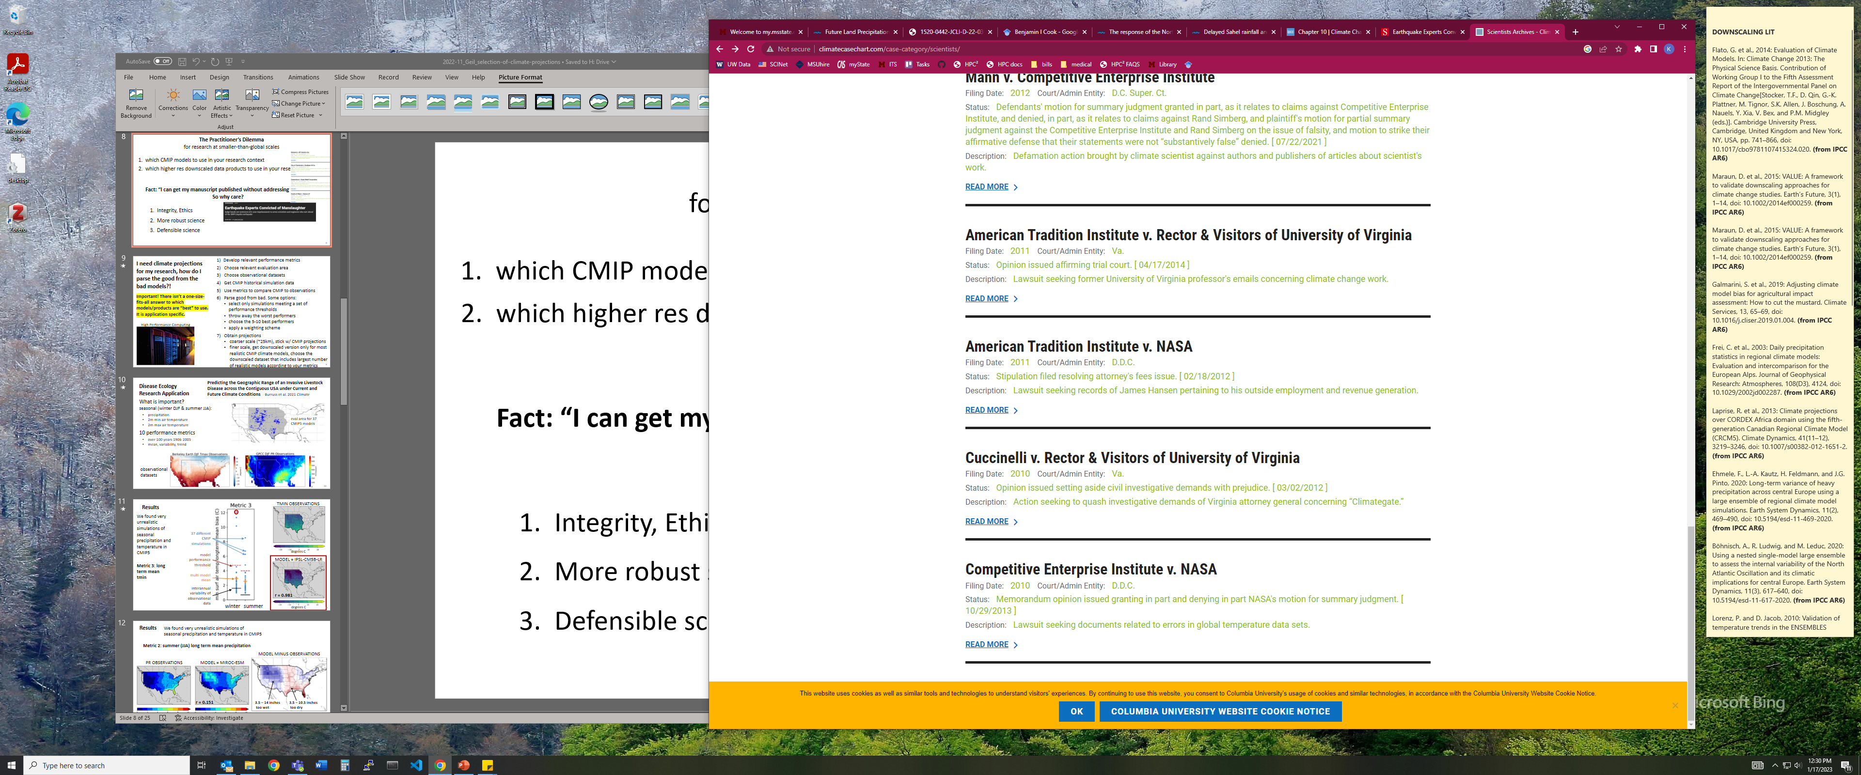
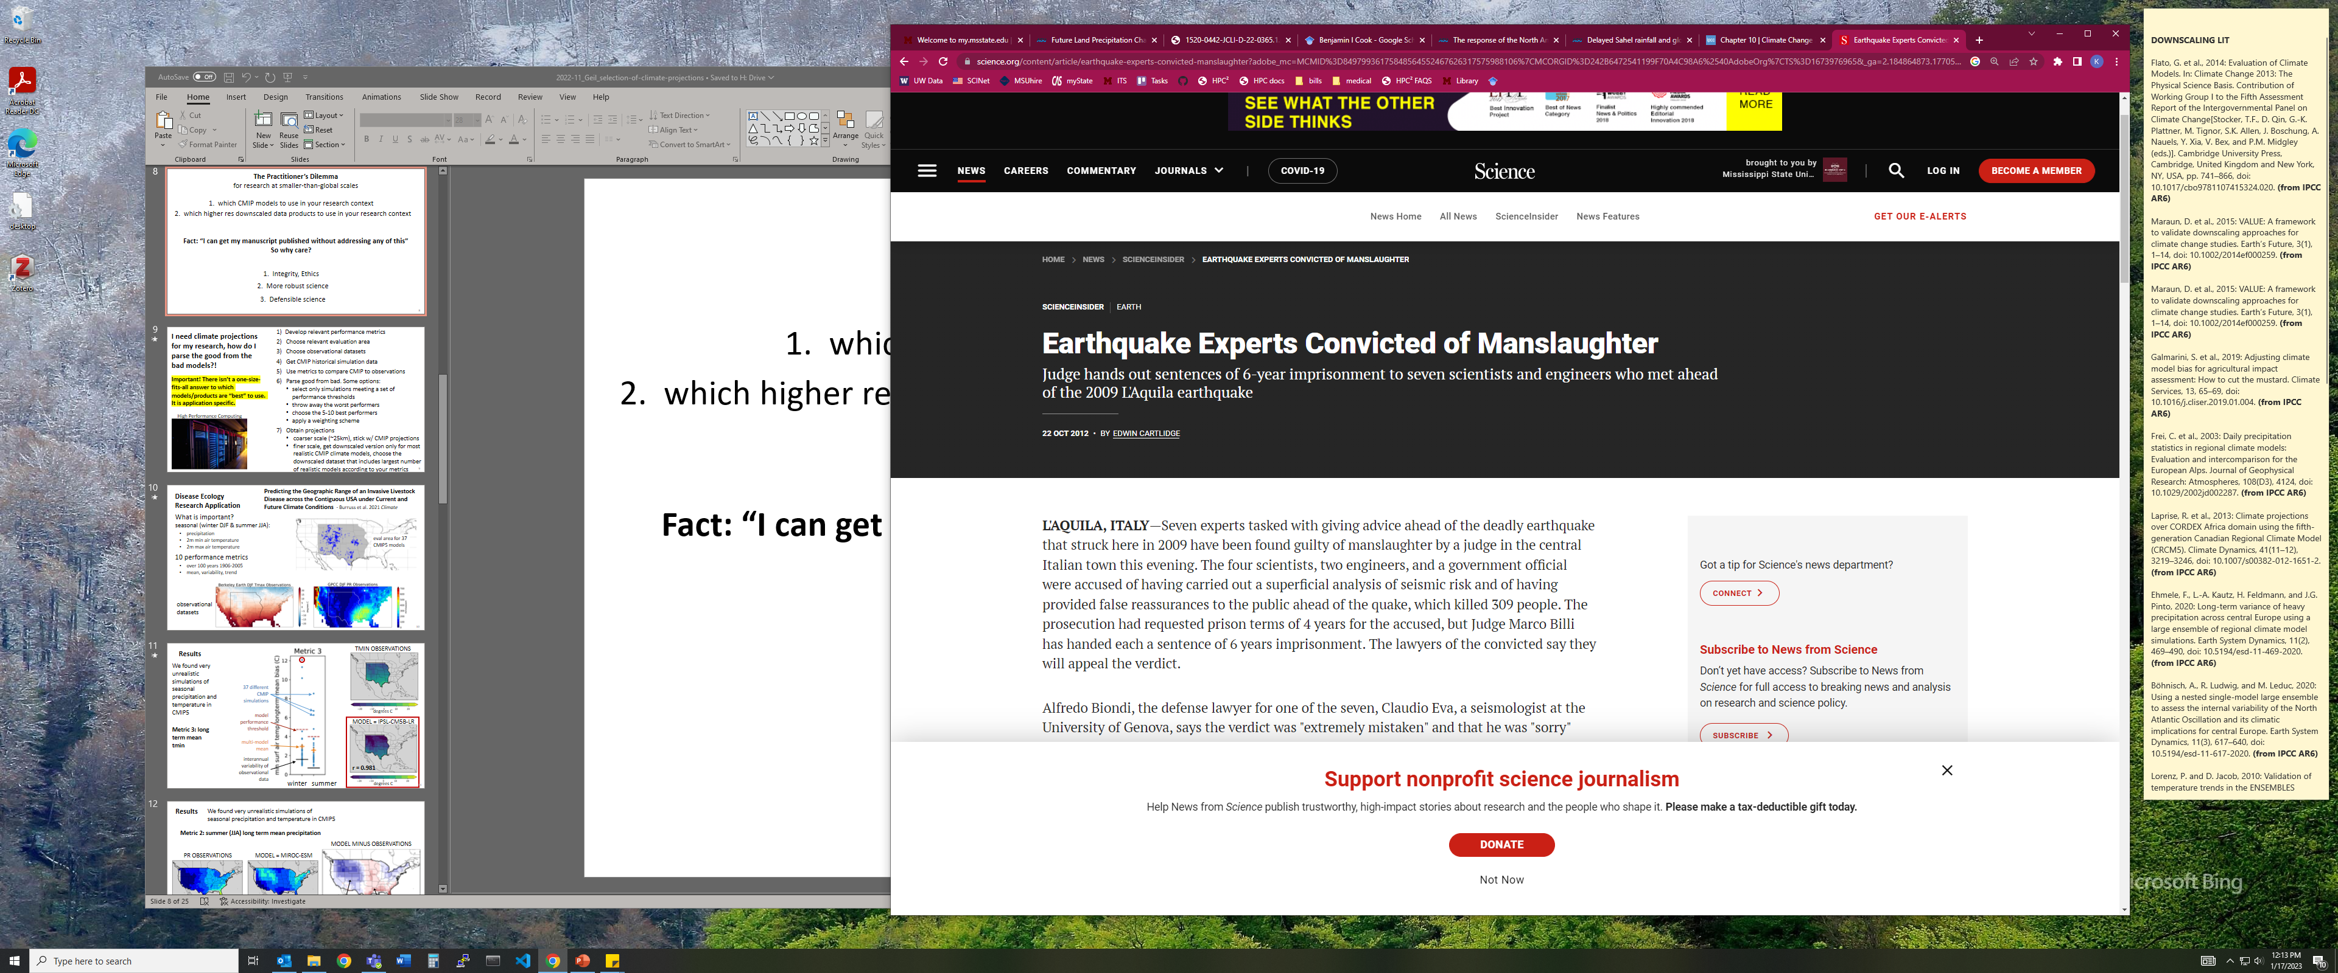
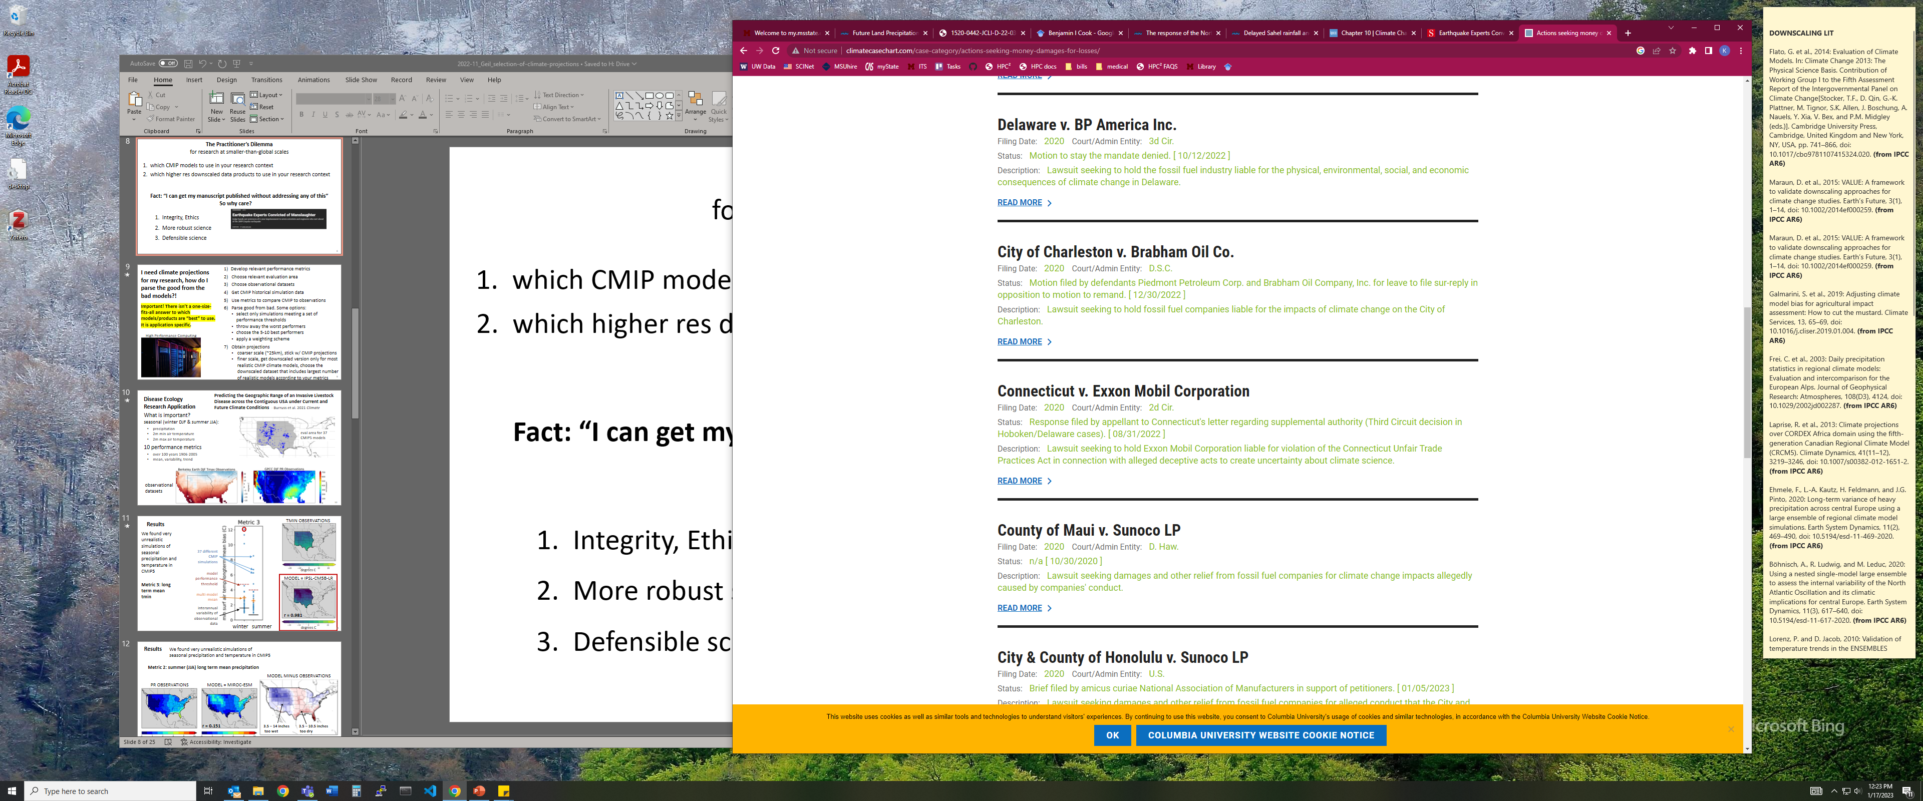
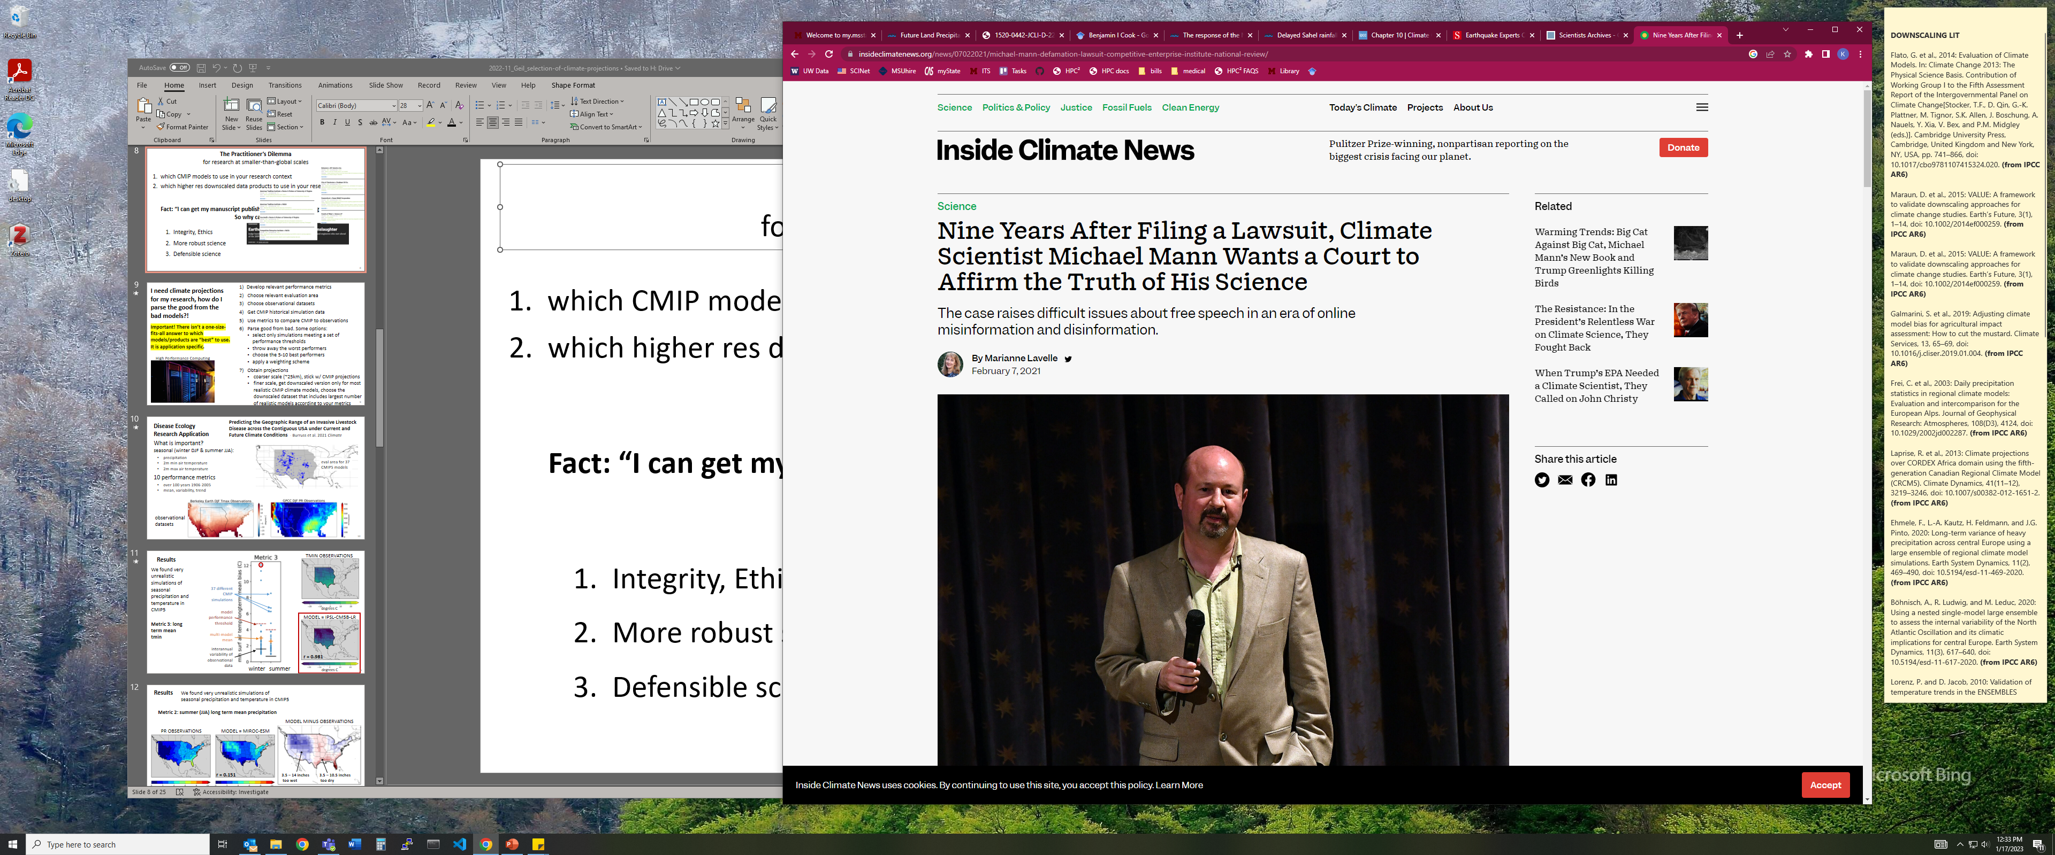
Climate Litigation
climatecasechart.com
climatecasechart.com
insideclimatenews.org

Slide 56
How much have you learned today?

Slide 57
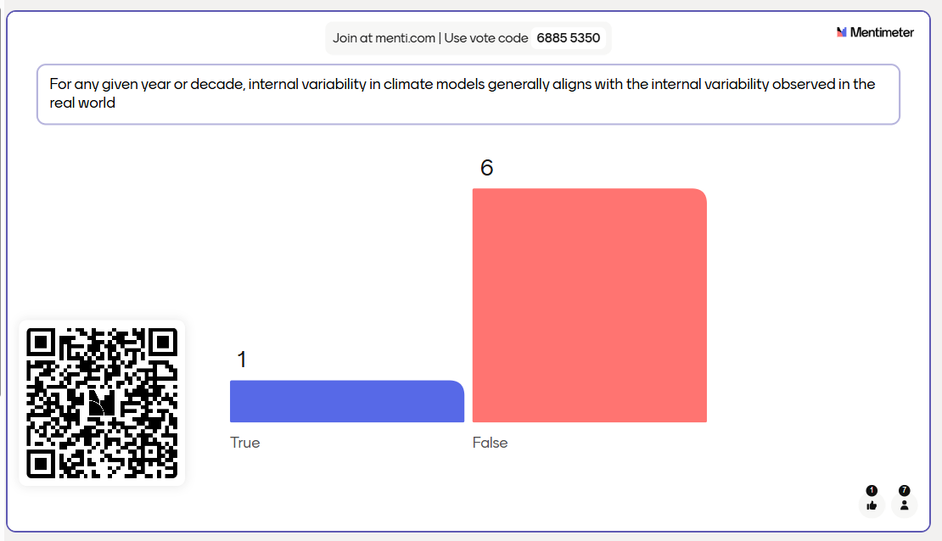


Slide 58



Slide 59



Slide 60



Slide 61



Slide 62



Slide 63



Slide 64



Slide 65



Slide 66



Slide 67
Exercise: Download and Plot CMIP6 Model Data
Download the following CMIP6 data: monthly precipitation (pr) from the ACCESS-ESM1-5 model, variant r1i1p1f1, for the historical and ssp245 experiments (this is 2 files, 288MB)
Plot a map of the 100-year mean (1915-2014) of August precipitation with units of mm/day and show coastlines.
Plot a timeseries of annual mean precipitation (1850-2100) in mm/day at the grid cell closest to your home town. Indicate where the data changes from the historical to the ssp245 experiment with color or a vertical line.
Get the data from any source you want and use any language you want. However, the solution will only be shown using ESGF and Python.
kerrie@gri.msstate.edu

